Slide 1
Evaluation and Narrative Feedback
Melissa Davidson, MD
Designated Institutional Official
Elise N. Everett, MD
Level Director of Clinical Clerkships
MD
Notes:
Thank you for taking time out of your busy days to attend our session on Evaluation and Narrative Feedback. I am Melissa Davidson and my co-host is Dr. Elise Everett.

Slide 2

Objectives
Formative and Summative Evaluation
Review LCME and ACGME standards for training in evaluation and feedback
Discuss nuts and bolts of evaluation (formative and summative), with application to residents, fellows, and faculty as both teachers and learners
Apply “Anatomy of an Effective Evaluation Statement” framework to reconstruct real-life examples of statements that range from unhelpful to unprofessional.
Notes:
Our objectives of this session are:

Slide 3

Why?
ACGME – Interpersonal & Communication Skills
  “Residents/Fellows must demonstrate competence in educating patients, families, students, residents, and other health professionals.”
Notes:
Why is it important as a resident/fellow/faculty member to be good at evaluating learners and providing narrative feedback. For residents/fellows it is an ACGME competency required for graduation from the training program.

Slide 4
Why?
LCME Standard 9:
“…a comprehensive, fair, and uniform system of formative and summative medical student assessment…”
“…protects medical students’ and patients’ safety by ensuring that all persons who teach, supervise, and/or assess medical students are adequately prepared for those responsibilities.”
EE
Notes:
For those who teach medical students, it is an LCME Standard or requirement for the LCOM to receive accreditation

Slide 5

Why?
LCME Standard 9.1
“…[provision of] resources to enhance residents’ and non-faculty instructors’ teaching and assessment skills…”
LCME Standard 9.5
‘…[ensure] that a narrative description of a medical student’s performance, including his or her non-cognitive achievement, is included as a component of the assessment in each required course and clerkship…”
Notes:
But even more important than the requirements, is that evaluation/assessment drives learning. It helps learners identify strengths and targeted areas for improvement. It improves learner knowledge, skills, and behaviors. It improves the efficiency of learning, rather than being “self-taught”. And most importantly, it leads to achievement of competency and quality patient care.

Slide 6

EE
Notes:
Thus, as an evaluator who does assessment and gives feedback, you have tremendous power and we are hear today to teach you how to use that power for good, not evil.

Slide 7
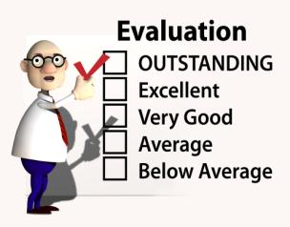
Evaluations
Formative
  During a time period
  Information is used to improve performance
  Timing is therefore important
Summative
  At the end of a time period
  Represents a final evaluation of performance

Slide 8
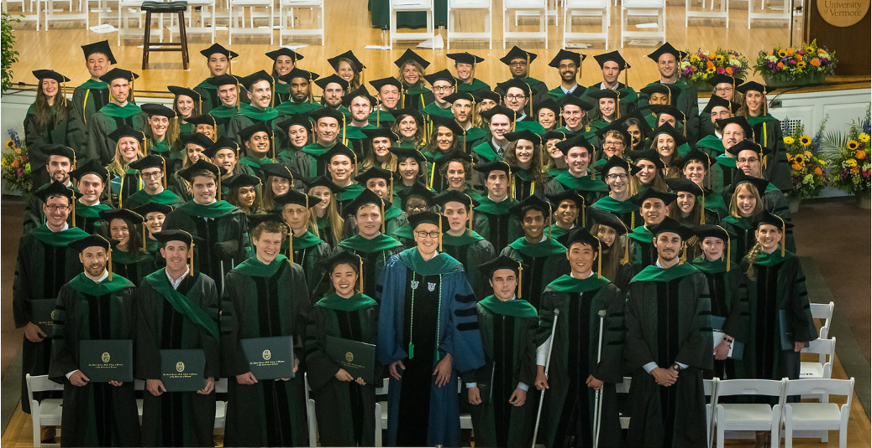

Evaluation Tools
WHY?
Outcomes:
  To facilitate continuous improvements in performance
  To certify competence
MD

Slide 9
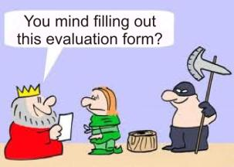

Global Evaluations
Overall, comprehensive view
  Series of statements about performance
  ± Comments
Variety of rating scales
  Numbers
  Agreement
  Satisfaction
  Behaviorally anchored

Slide 10
Rating Scales
Strongly disagree
Disagree
Neither agree nor disagree
Agree
Strongly agree
Unsatisfactory
Marginal
Satisfactory
Very Good
Excellent
Unsatisfactory
Poor
Good
Excellent
Outstanding
Unsatisfactory
1 2 3
Good
4 5 6
Excellent
7 8 9
Poor
Good
Excellent
Outstanding
Top 5%

Slide 11
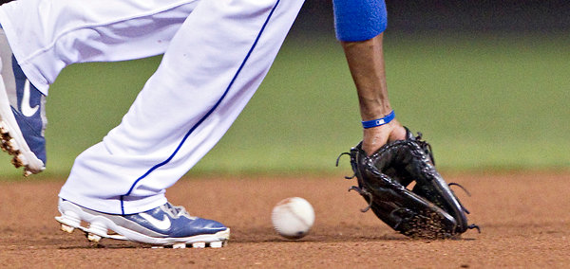
Global Evaluations: Errors
Pre-conceived ideas
First / last interaction
Stringency / Leniency bias
Central tendency
Recency bias
Halo effect
Notes:
Pitchfork effect

Slide 12
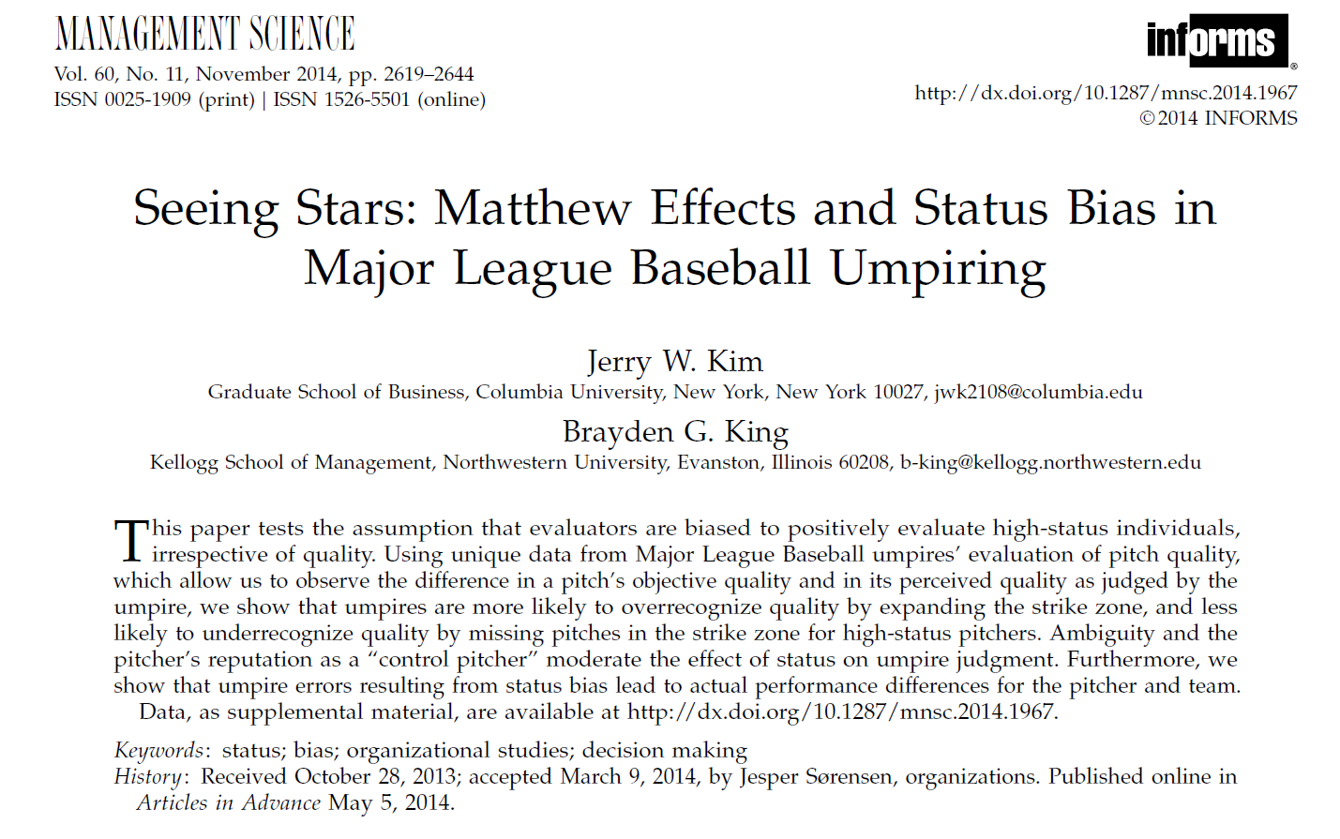
MD

Slide 13
Bias
Black/African American students were less likely to receive honors compared to White medical students in 6 of 6 clerkships.
Asian and Hispanic students were also less likely to receive honors compared to White students in 3 of 6 clerkships.
Women were less likely to receive honors compared to men in 1 of 6 clerkships
Controlling for shelf exam scores, race/ethnicity remained significantly associated with grades
URiM students 3x less likely to be selected for AOA (Teherani et al. Acad Med. 2018;93:1286-1292)
Washington University School of Medicine in St. Louis Case Study: A Process for Understanding and Addressing Bias in Clerkship Grading. Academic Medicine. DOI: 10.1097/ACM.0000000000003702.

Slide 14
Mitigating Bias
Improve and Standardize clerkship assessment
Provide equitable access to study resources
Better prepare students for the clinical learning environment
Improve the learning environment and reporting mechanisms for bias
Improve faculty and trainee diversity
Create a continuous QI process
Washington University School of Medicine in St. Louis Case Study: A Process for Understanding and Addressing Bias in Clerkship Grading. Academic Medicine. DOI: 10.1097/ACM.0000000000003702.

Slide 15
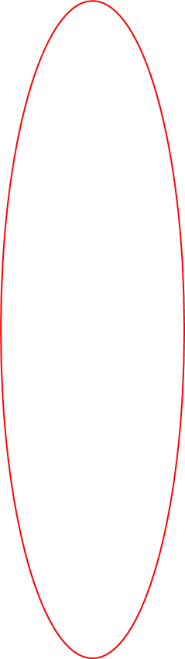

Rating Scales
Strongly disagree
Disagree
Neither agree nor disagree
Agree
Strongly agree
Unsatisfactory
Marginal
Satisfactory
Very Good
Excellent
Unsatisfactory
Poor
Good
Excellent
Outstanding
Unsatisfactory
1 2 3
Good
4 5 6
Excellent
7 8 9
Poor
Good
Excellent
Outstanding
Top 5%

Slide 16
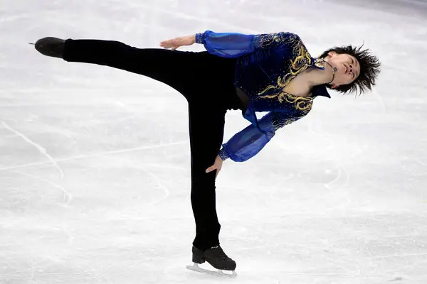
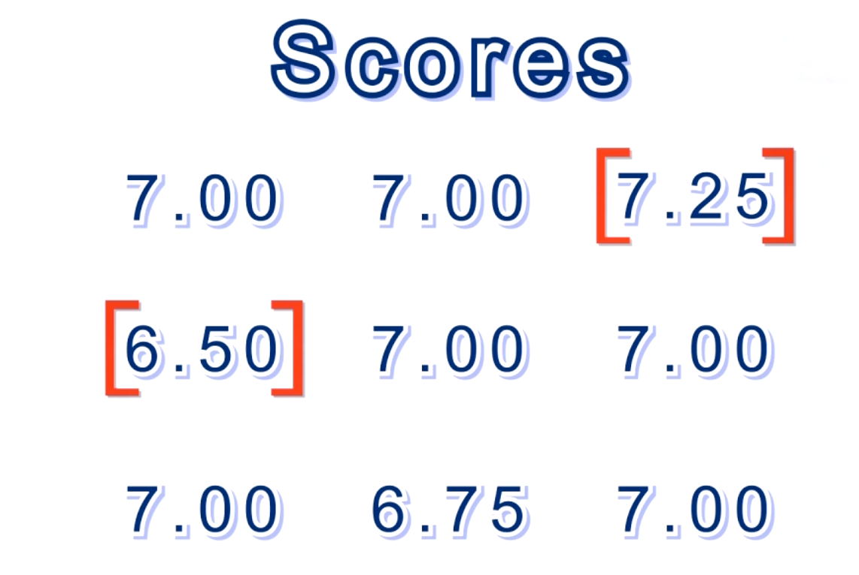
Evaluations: Rating Scales
Lenient and stringent errors cancel each other out
  ≥7 raters

Slide 17
Rating Scales
Strongly disagree
Disagree
Neither agree nor disagree
Agree
Strongly agree
Unsatisfactory
Marginal
Satisfactory
Very Good
Excellent
Unsatisfactory
Poor
Good
Excellent
Outstanding
Unsatisfactory
1 2 3
Good
4 5 6
Excellent
7 8 9
Poor
Good
Excellent
Outstanding
Top 5%

Slide 18
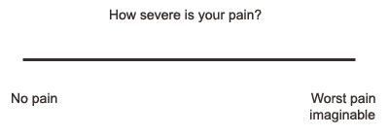
How good is the student?
Best student
Worst student

Slide 19
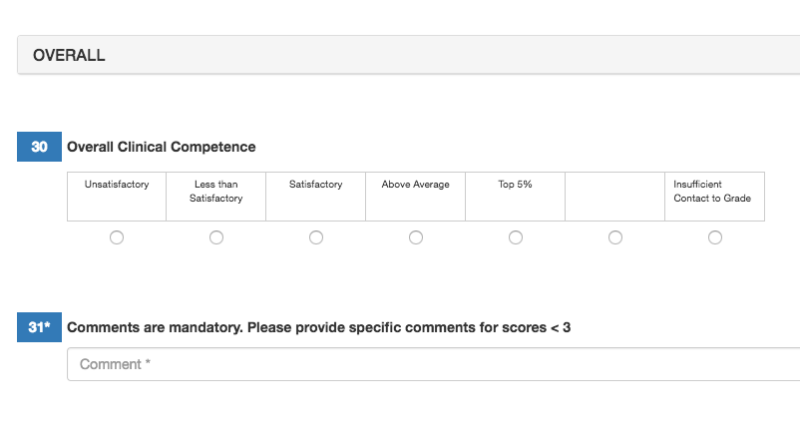
Comments

Slide 20


Notes:
TIME for an EXERCISE. Breakout rooms (8 rooms with 7 attendees).

Slide 21
The most unhelpful positive comment you (or a friend) received on an evaluation.
The worst comment you (or a friend) received on an evaluation.

Slide 23
Dean’s Letter (MSPE)
Faculty evaluations, Formative/Summative
Summative Clerkship Evaluation
Medical Student Performance Evaluation (MSPE) or Dean’s Letter
  A permanent document that follows the individual
  Can impact on residency selection
Be careful and thoughtful about what you write!
  Say something meaningful
  Avoid clichés
  Write full sentences
EE
Notes:
Think before you write!
Avoid great job, good on the floors, spent a good month with us.

Slide 24



Evaluation Process
Observed Clinical Activity
Resident/Fellow/
Faculty Evals
Summative Clerkship Evaluation
MSPE
Notes:
The process can break down at multiple points. Shadowing, no participation: No direct observation: Poorly written formative evaluations: Poorly written summative evaluations: Poorly written MSPE

Slide 25
Specific
Corrective Specific
Reinforcing Specific
Corrective Global
Reinforcing Global
Corrective
Reinforcing
Global
MD
Kruidering-Hall M, et al. JGIM 2009; 24(6):721–6

Slide 26

Guidelines
Focus on behaviors and observations
  Avoid generalizations
Provide examples
Suggest ideas for future improvement
If conclusions are drawn based on observations and facts, consider framing statements:
  “…all of which leads me to conclude that…”
  “…my perceptions of their behavior…”

Slide 27
Specific
“Knowledge could be enhanced by reading about the clinical diagnosis, the surgical steps and relevant anatomy before coming to surgery.”
“Came to clinic prepared, on time, and was an active participant, which made them a joy to have in clinic.”
“Needs to READ more.”
“A joy to have in clinic”
Corrective
Reinforcing
Global
EE
Notes:
This is an example of student evaluations of a course or of a faculty. Can anyone give an example of a Corrective Specific comment they

Slide 28


Notes:
Now a review of the anatomy of a GOOD narrative feedback statement.

Slide 29
Anatomy of a feedback statement:
good
Corrective, Specific
Student X spent a lot of time on their phone during clinic. This made me feel that the student was uninterested in the material. In the future, it would be helpful if the student stated, “I am going to look up the guidelines on my phone”.
Reinforcing, Specific
Student Y was a joy to have in clinic! She always came prepared having read about the patients the night before. She prepped her notes the night before clinic. She gave took organized, succinct histories in a busy clinic to keep us running on time. She made my first preceptor experience a great one!
MD

Slide 30
Re-frame:
The worst comment you (or a friend) received on an evaluation.
MD
Notes:
Ask the group to re-frame the worst comment they have received on an evaluation.

Slide 31

Notes:
Circle of Life

