Slide 1
Rural-Urban Differences in Stroke Risk
George Howard
Department of Biostatistics
UAB School of Public Health
Birmingham, AL

Slide 2
I have nothing to disclose

Slide 3
Why Focus on Health Disparities?
Health disparities are immense, and it is just the right thing to do!
… but also the Minority Health and Health Disparities Research and Education Act (United States Public Law 106-525;2000, p. 2498) instructs NIH to assess disparities, with a focus on:
  Minority health research and related activities
  Rural health research and related activities
  Research and other activities related to the socioeconomically disadvantaged in the urban setting.
… also, Healthy Persons 2030 (the guiding document for all of HHS)
  Among 7 founding principles: Achieving health and well-being requires eliminating health disparities, achieving health equity, and attaining health literacy.
  Among 5 overarching aims: Eliminate health disparities, achieve health equity, and attain health literacy to improve the health and well-being of all.

Slide 4
Recent Pattern of Urban-Rural Disparities in Stroke Mortality
CDC WONDER: 1999 – 2018
2013 Urbanization categories

Slide 5


What we know
… and what we need to know
Stroke
Mortality
Stroke
Incidence
Case Fatality after Stroke
=
x
If stroke incidence is driving disparity …
then need to focus on prestroke prevention in the general population
If case fatality is driving disparity …
then need to focus on
severity disparities, and
improved care in the hospital
We know there is rural excess stroke mortality defined on the basis of Vital Statistics data
So is it that those living in rural areas:
Are having more strokes?
Are more likely to die following stroke?
Or both?
And what does this have to do with targeting interventions?

Slide 6
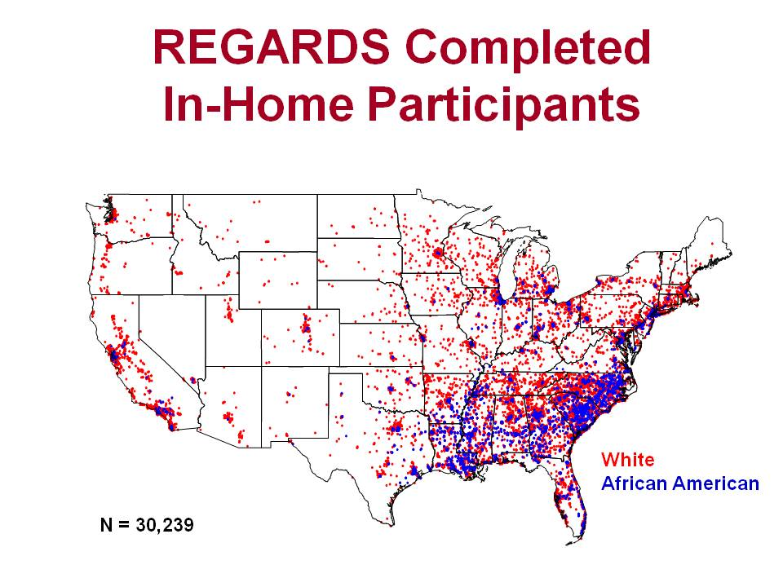
Current Aims and Methods
The rest of the data for this talk are from the:
REasons for Geographic And Racial Differences in Stroke (REGARDS) Study
General population study with diverse aims … but for today …
Central participant recruitment and telephone interview
  30,239 white and black participants aged 45+
  56% from the Stroke Belt
  42% black
In-home evaluation for physical, venipuncture and ECG
Central follow-up at 6-month intervals for detection of suspected stroke events (and other outcomes)
Physician adjudication of new stroke events
Provides both measures of stroke incidence and case fatality
One of the very few cohort studies with data from rural areas

Slide 7
… and using these data, let’s focus on two questions
Is it that rural people are having more strokes, or is it that a person living in rural area is more likely to die after having a stroke?
… and cheating and looking ahead, what is it that makes rural people more likely to have a stroke?

Slide 8
Statistical Methods for Question 1
(Incidence versus Case-Fatality as the Contributor to Rural Excess)
Two separate analyses
  Incidence
    Outcome: Incidence of stroke
    Proportional hazards analysis, adjusting for age, race, sex and region
  Case fatality
    Outcome: Death within 30-day among those with a stroke
    Logistic regression analysis, adjusting for age, race, sex and region
Adjustment for region allows contrasting rural-urban differences while removing confounding with larger Southern rural population
In both cases – assess interactions between age, race and sex, and include significant terms (p < 0.10)
Howard G, et al. Stroke 2016;47:1893-1898

Slide 9
Question #1: Incidence vs Case Fatality as the Contributor to Urban-Rural Differences in Mortality
Urban-rural disparities seem driven by higher incidence, with case fatality playing minor role
Again … this implies that reduction of the disparities needs to focus on reduction of stroke risk in rural areas
(more than improved stroke care in rural areas)
But what seem to be the contributors to the higher incidence (a.k.a., question #2)?
Howard G, et al. Stroke 2017;48:1773-1778

Slide 10
Statistical Methods for Question 2:
(What are the apparent contributors to the excess stroke incidence in rural areas?)
General approach:
We start by considering risk factors and socio-economic status factors that we know are associated with stroke
and then
See if these same factors have a worse profile in rural areas,
If so, we then we can adjust for these factors to see if it will attenuate the magnitude of the estimated rural excess of stroke (a.k.a. mediation analysis)
Factors considered include:
  Risk factors: hypertension, diabetes, smoking, atrial fibrillation, left ventricular hypertrophy, and heart disease
  SES: household income ≤$35K, education ≤ high school, and neighborhood SES
“Traditional” index calculated at the Census tract level, including:
median household income
median value of housing units
proportion of households receiving interest-dividend-rental income
proportion of adults with a high-school diploma
proportion of adults with college degree
proportion of people used in executive-managerial-professional occupations

Slide 11
Step 1: Are Stroke Risk Factors and SES more Adverse in Rural Areas?
We already know that these risk factors and SES measures are related to stroke
… so now let’s see how much of the rurality → stroke-risk relationship is mediated by adjustment for them?
1. Gee … this looks promising … there is more hypertension, diabetes, LVH and HD in rural areas
Calculate the odds of prevalent condition after adjustment for age, sex, race and geographic region … looking for a “dose-response” relationship with rurality
2. Gee … even more promising for SES measures

Slide 12
Why is the incidence of stroke higher in rural areas?
So here is that relationship we had with incidence
23% → 18% = 22% attenuation
30% → 19% = 37% attenuation
So adjustment for risk factors, and subsequent adjustment for SES, does partially mediates association … it even becomes non-significant
Most of this attenuation seems tied to SES measures
Suggests that risk factors and SES are contributors to excess rural stroke mortality … and are targets for intervention
However, (while no longer significant), over half the association remains
Gee … we need to understand what else is contributing
What does adjustment for risk factors and SES do to this relationship?

Slide 13
What else could be going on?
Well … lots!
Other factors could be playing a role, including:
  Psychosocial
  Structural
Age-race-sex adjusted prevalence of depression is higher for rural than urban participants in the 1999 National Health Interview Survey
(OR = 1.19; 95% CI: 1.03 – 1.38)
Probst JC, et al. Fam Med 2006;38:653-660
  Environmental
  Of course, others!
Residual confounding
  We have adjusted for hypertension, but that fails to capture the distribution of blood pressure
  In unpublished work by Dr. Brittain Heindl, he examined the percentiles of SBP after adjustment for age, race, sex, state, and use of antihypertensive medications
Effect modification
  Don’t have a good example … but there could be factors more “potent” in rural areas
Measurement error
No good talk neglects to state that a lot more work is needed to understand these effects!

Slide 14
Conclusions
Data from Vital Statistics shows a nearly monotonically higher risk of stroke death with increasing rurality
  This disparity increased from ≈16% in 1999 → ≈25% in 2009
  Has been fairly rapidly decreasing to ≈11% in 2018
Data from REGARDS shows:
  The higher risk in rural areas appears to be nearly completely related to higher stroke incidence in rural areas (with higher case-fatality playing a minor role)
  This suggests the focus of interventions needs to be community-based efforts to reduce risk of incident stroke in rural areas
  A heavier risk factor burden and poorer SES profile contribute about 25% to 35% of this excess, and are clearly targets for intervention
  This implies that the factors driving 65% to 75% of the excess are not understood (… yes … the more work is needed statement)
We welcome others to join in analysis of REGARDS data to better understand this disparity

Slide 15
Acknowledgments
REGARDS is supported by cooperative agreement U01 NS041588 from NINDS/NIH-NIA
We thank the investigators, staff, and participants of the REGARDS study for their valuable contributions. A full list of participating investigators and institutions can be found at http://www.regardsstudy.org

Slide 16
REGARDS Functional Units
Central laboratory: University of Vermont; Drs. Mary Cushman, Neil Zakai, Tim Plante, Rebecca Boyle, Debora Kamin Mukaz
Neuropsychology Centers:
Columbia University:
Dr. Jennifer Manly
University of Indiana;
Dr. Fredrick Unverzagt
UAB: Drs. Virginia Wadley, Michael Crowe, David Geldmacher, Erik Roberson
Statistical Advisory:
Drexel University: Dr. Leslie McClure
Neuroepidemiology Center: University of Cincinnati; Drs. Brett Kissela, Matt Flaherty + Dr. Karen Albright- SUNY Upstate + Tracy Masden- Brown University
Funding Agency: NINDS: Drs. Claudia Moy, Rod Corriveau
Survey Design: University of Arkansas; Dr. LeaVonne Pulley
ECG Reading Center: Wake Forest University; Dr. Sayed Soliman
Coordinating Center (UAB); Drs. Suzanne Judd, George Howard, Virginia Howard, Leann Long, Virginia Wadley, Ryan Irvin, April Carson, Michael Crowe, Mr. David Rhodes, Ms. Meg Stewart, Mr. Paul Wolff, Ms. Cassandra Johnson
Home Visits (Baseline + 2nd): Examination Medical Services, Inc.; Ms. Andra Graham

Slide 17
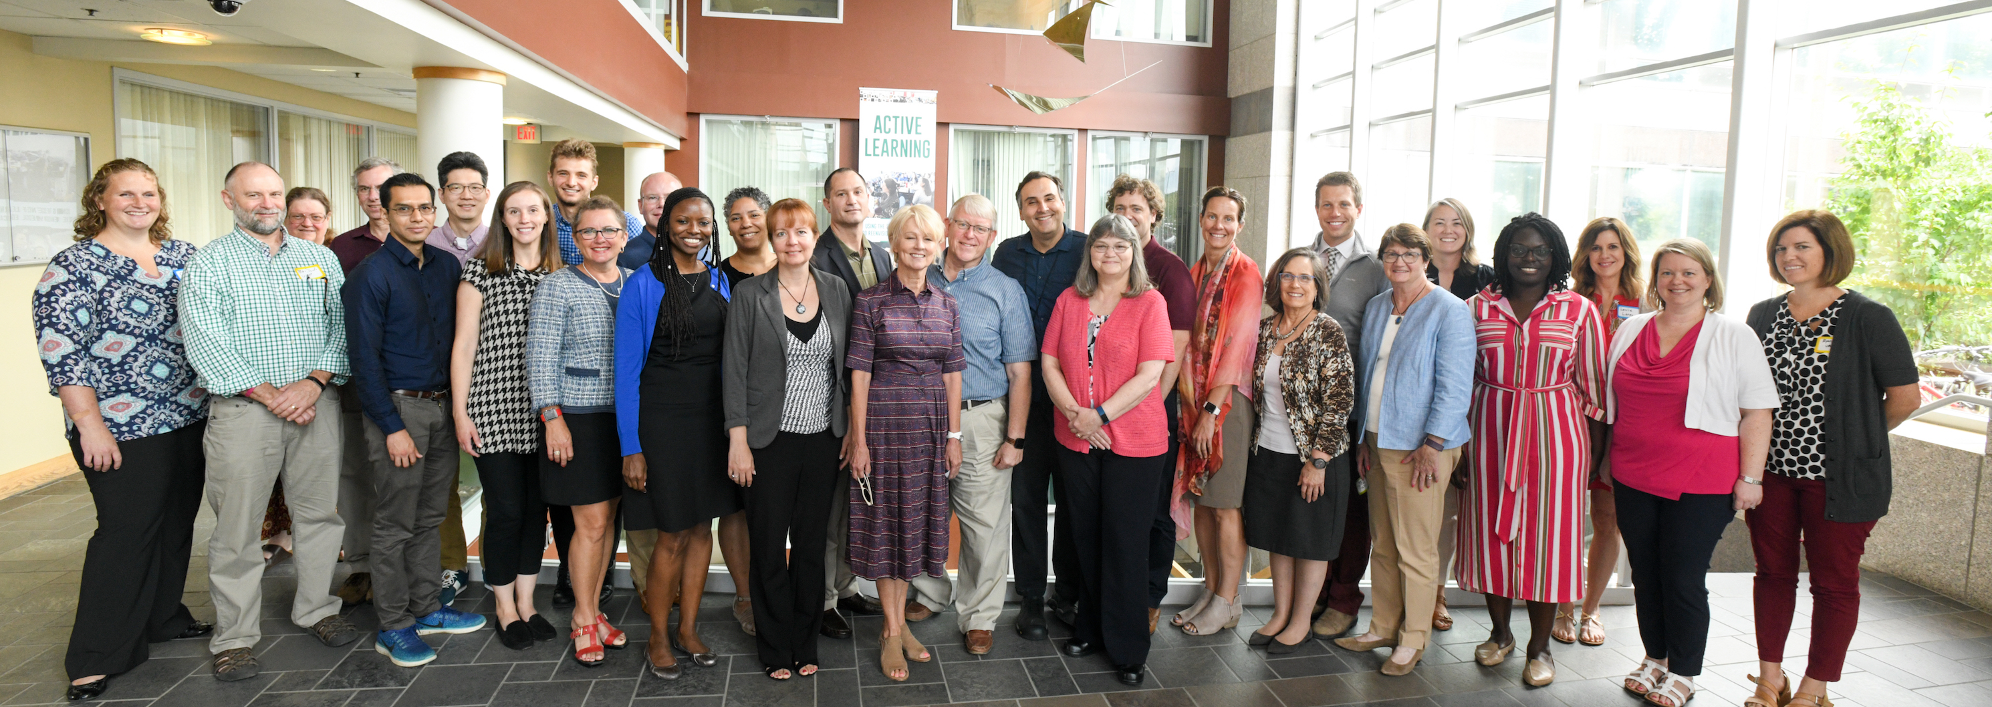
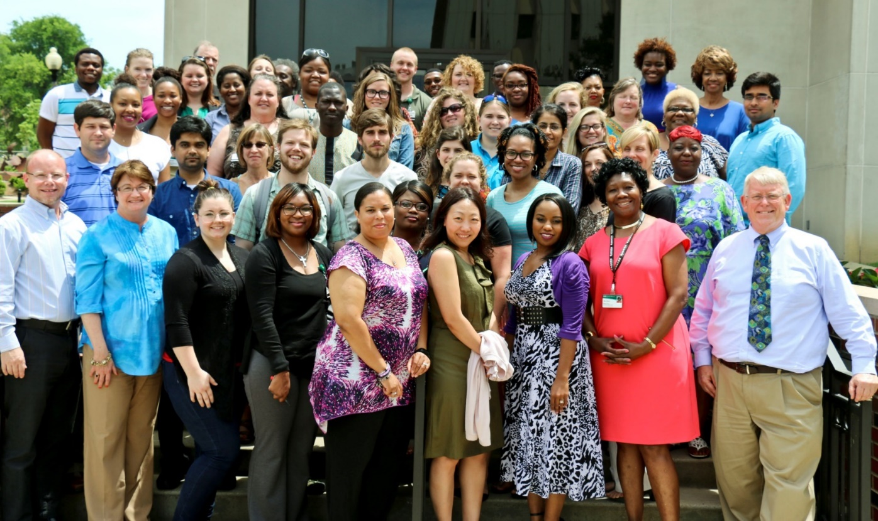

Questions?

Slide 18
NIH/NINDS U01 NS41588

Slide 19
Recent Pattern of Urban-Rural Disparities in Stroke Mortality
(1999 – 2018)
2006 Urbanization categories

