Slide 1
LCOM Active Learning Images
Copy images to your presentation. To properly resize an image: highlight the image, hover over the corner of the image until your curser becomes an arrow, hold the shift key while you select a corner and drag it inside or outside the image until it is the desired size.

Slide 2
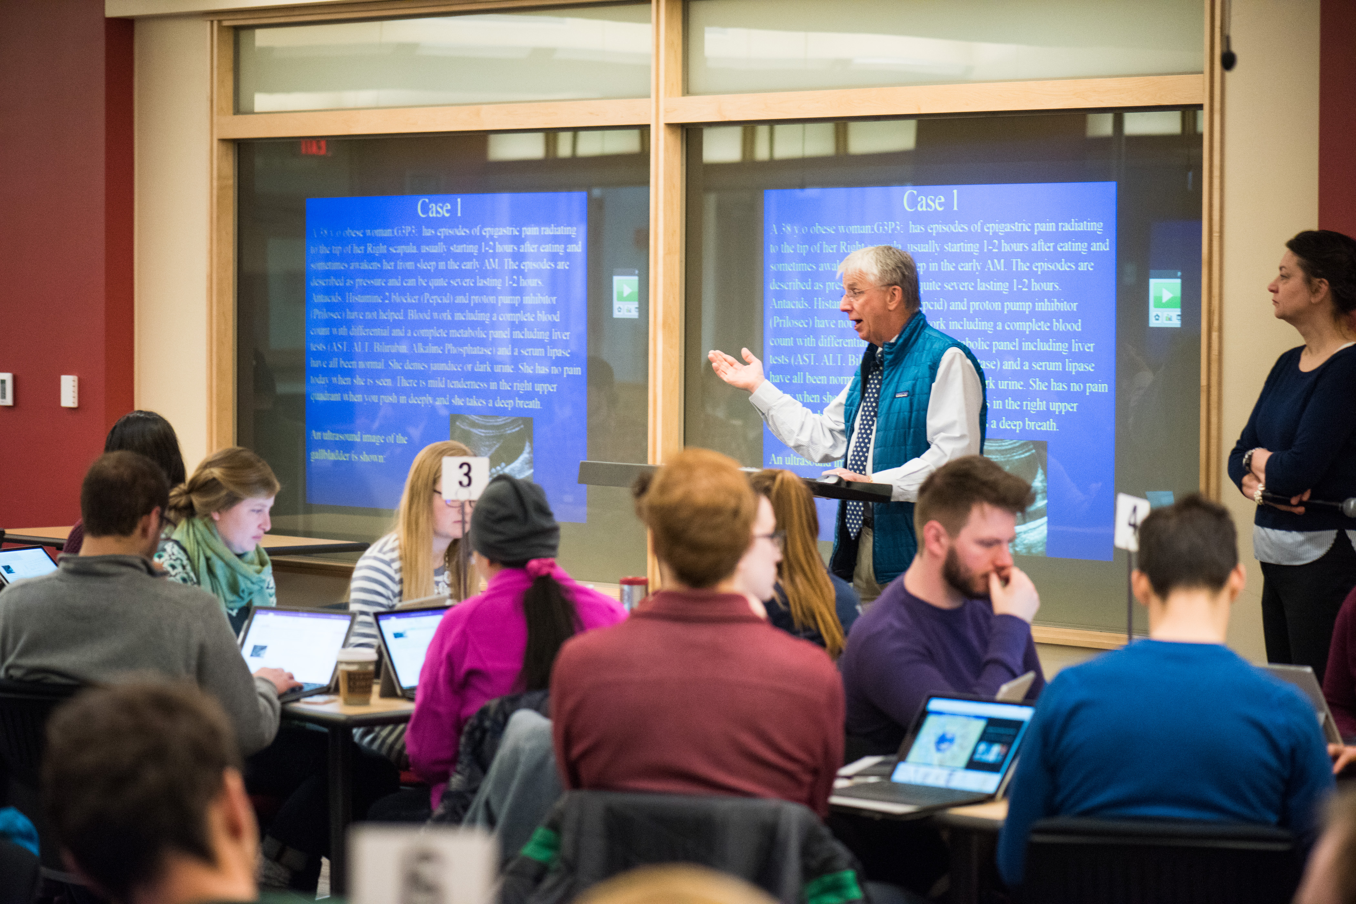

Slide 3


Slide 4
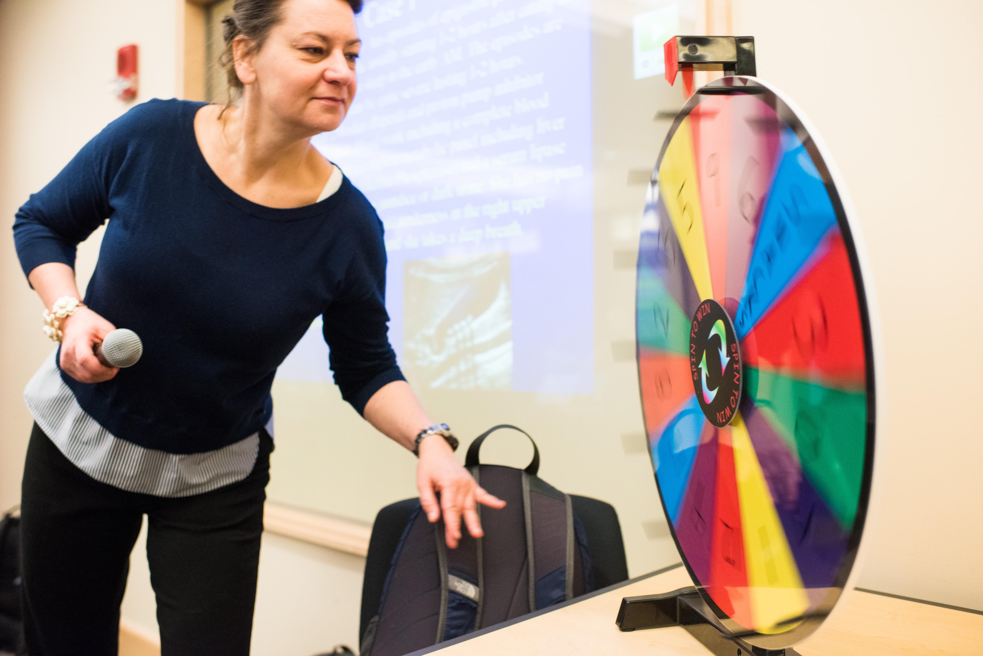

Slide 5


Slide 6
