Slide 1
Recognizing and Responding to Bias in Medical Education: Guide to Developing and Delivering Inclusive Content
Tim Lahey, MD, MMSc, Director of Clinical Ethics, Professor of Medicine
Karen Lounsbury, PhD, Director of Foundations and Pre-Clinical Assessment, Professor of Pharmacology
Eileen CichoskiKelly, PhD, ODEI Academic Excellence Liason, Associate Professor of Family Medicine
Pamela Gibson, MD, Vice Chair of Pathology & Laboratory Medicine, Associate Professor of Medicine
Julia O’Connor, Instructional Designer, Office of Medical Education
With thanks to Mercedes Avila, PhD

Slide 2
Objectives
Recognize the importance of presenting content that includes diverse populations as part of a comprehensive medical curriculum
Discuss the consequences of perpetuating bias on health care equity
Outline the obstacles to using inclusive clinical cases in medical education
Evaluate case examples to identify stereotypes and apply best practices to deliver inclusive curriculum content
Practice using respectful language when responding to student feedback related to bias
Utilize provided resources to develop future teaching materials that avoid bias and contain inclusive content

Slide 3
Session outline
Discuss the importance and challenges of reducing bias in medical education
Critique stereotyping in teaching cases – & identify solutions
Identify pitfalls in case selection within courses – & identify solutions
Discuss how to structure case-based conversations about social determinants of health
Discuss productive responses to student feedback
Resources for developing inclusive content

Slide 4
The Importance of Reducing Bias in Medical Education: Keynote Speaker Recap
Strategies for Fostering and Supporting Diversity, Equity, and Inclusion in the Learning Environment Marissa Coleman, PsyD; Lee Rosen, PhD

Slide 5
Health care interacts with and perpetuates the other social determinants of medicine
Medical Education plays an important role in breaking the cycle of structural racism in medicine
Schroeder NEJM 2007

Slide 6
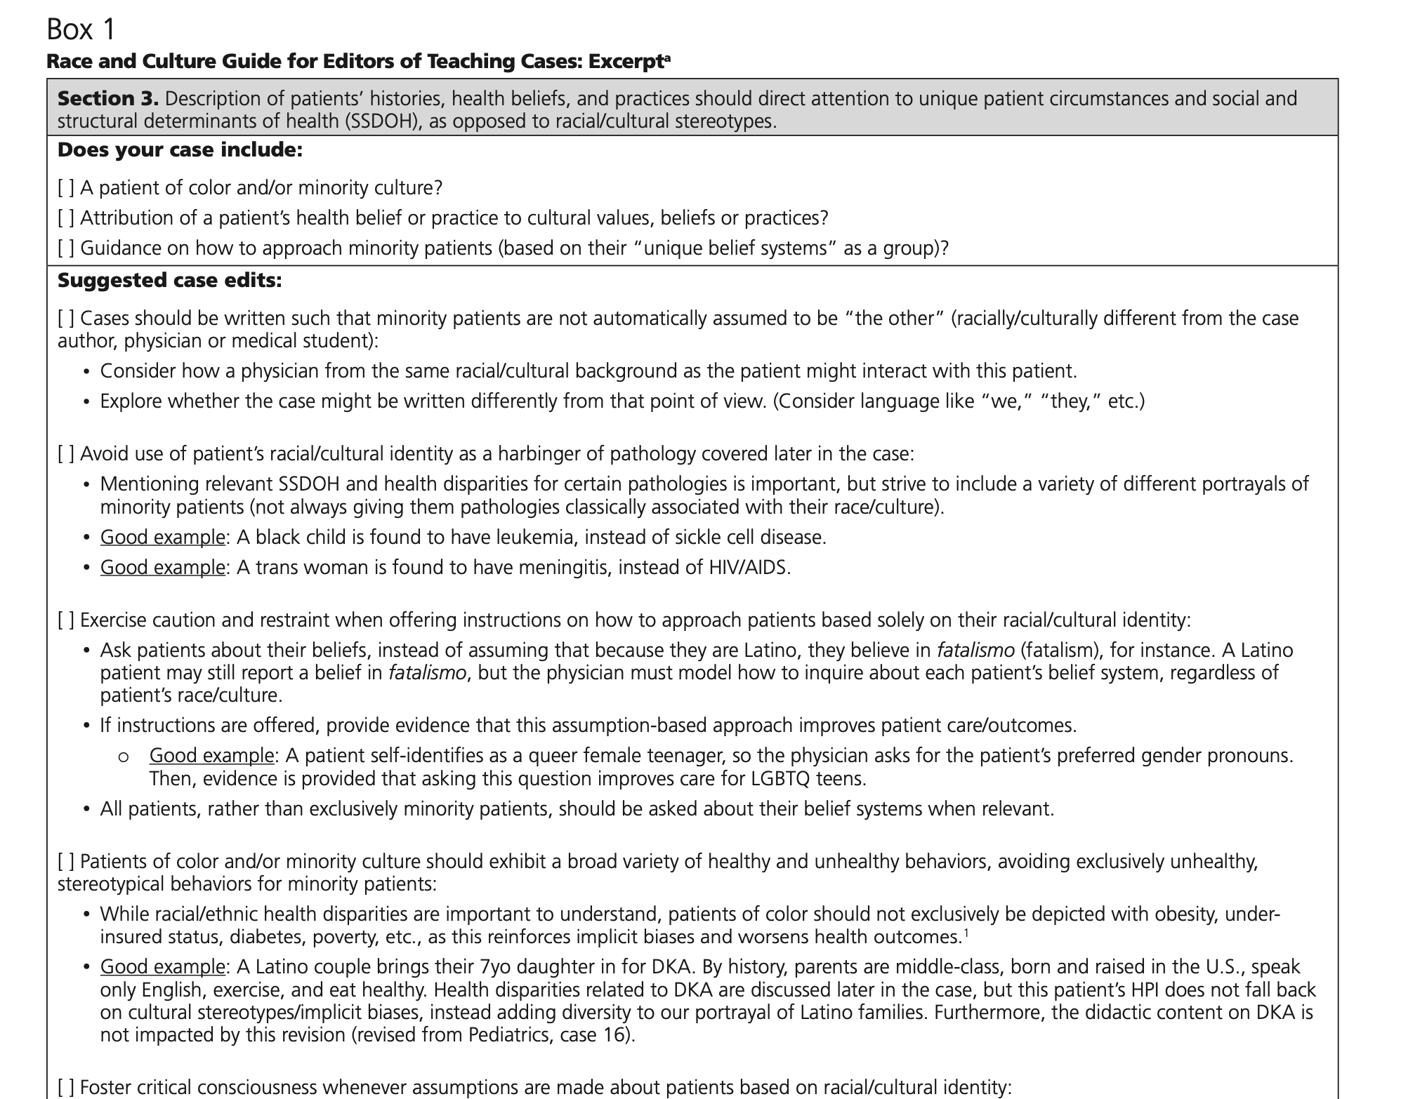
Challenges to implementing changes

Slide 7
What problems or challenges have you seen (or are you concerned about) in regards to writing inclusive cases?
Please write questions in the chat

Slide 8
Identifying stereotypes within case studies Exercise #1: 15 minutes
Participants will be sent to breakout rooms
Introduce yourselves and describe why you have joined this session
Critique stereotyping in each case
Suggest revisions to the case or question that would reduce stereotyping and lead to a high-quality discussion of the social determinants of health
Choose a group member to report out

Slide 9
1
A 32-year-old homeless African American man from inner city Chicago is being evaluated in the emergency department with pain in all joints he says is consistent with prior sickle cell crises. His fingertips hurt particularly. He says 75 micrograms of fentanyl is too small a dose. Past medical history includes an episode of Salmonella bacteremia 5 years ago. He takes no medications prior to arrival and has no drug allergies. He is homeless. He does not smoke or drink alcohol but readily admits to a prior history of opioid use disorder. No other illicit drug use. Temperature 37.2. BP 140/90 HR 120 and RR 20. O₂ saturation 94% on room air. Physical examination reveals no rash. There are crackles in the right lower chest but no associated dullness to percussion. Labs are notable for hemoglobin of 8 g/dL, decreased from 10 g/dL approximately 3 months ago. A chest x-ray confirms a right lower lobe infiltrate. A peripheral smear confirms the presents of misshapen erythrocytes. Blood cultures are pending.
Describe what pathophysiological mechanism likely triggered this patient’s pain and decreased hemoglobin.
Name and justify the antibiotic you would start for this patient’s infection.
What medication would you prescribe to prevent future episodes, and how does it work?
2
A 26-year-old paralegal presents to the emergency department with fever and a non-pruritic rash. He denies headache. He underwent breast augmentation surgery as well as a procedure to make his chin and Adam’s apple less prominent. No genital surgery to date. He takes estrogens daily. One unsuccessful suicide attempt at the age of 14. He is promiscuous with multiple male partners whom he meets on an online hook up app. When asked about condoms, he looks a uncomfortable – then admits he does not use them. No family history of immunodeficiency. Temperature 38.2. Vitals otherwise stable. There is are innumerable rounded well-demarcated macular erythematous spots on his trunk, and arms (including the palms of his hands) and legs (including the soles of his feet). Genital examination shows normal male external genitalia without any ulcerative lesions. CBC and chemistries are normal. A rapid HIV test is negative. A serology returns positive for a spirochete.
Rank in order of likelihood the following pathogen: Neisseria meningitidis, Treponema pallidum, Borrelia burgdorferi. Why?
Describe the mechanism of action of the most effective therapy.
How can you get this patient to use condoms more consistently?
3
A 48-year-old Latina is vising with her primary care physician. She says she feels tired. Past medical history is notable for type 2 diabetes mellitus, hypertension and morbid obesity. She is prescribed metformin and lisinopril but admits poor adherence. She works as an administrative assistant for a large paper factory. A single mother, she is raising four children under the age of 10. All are your patients; all are overweight. When asked about diet, she says “I make sure they get a protein, maybe carne asada, with every meal. Some rice. Beans.” Vegetables are uncommon. She says they consume a gallon of Coca-Cola daily. Her family history is notable for type 2 diabetes in multiple family members. Her father died of a myocardial infarction at the age of 49. Blood pressure is 160/96. Other vitals are normal. BMI is 33. She avoids eye contact. Beyond decreased monofilament sensation in the soles of her feet, examination is normal. Creatinine is stable at 0.8. Hemoglobin A1c is 11. Total cholesterol is 266. Urinalysis shows 1+ protein.
How does this patient’s diabetes likely cause proteinuria?
What is the mechanism of action of metformin and the second drug you are likely to add?
To help with disease prevention, what modifications to the typical Latin diet would you suggest?

Slide 10
Exercise #2: 10 minutes Avoiding pitfalls in the selection of cases
Participants will be sent to breakout rooms
List ways the selection of cases in general could lead to stereotyping or other issues that go beyond the language of individual cases
Identify ways of improving materials related to other course content
Choose a group member to report out

Slide 11
1
A 32-year-old homeless African American man from inner city Chicago is being evaluated in the emergency department with pain in all joints he says is consistent with prior sickle cell crises. His fingertips hurt particularly. He says 75 micrograms of fentanyl is too small a dose. Past medical history includes an episode of Salmonella bacteremia 5 years ago. He takes no medications prior to arrival and has no drug allergies. He is homeless. He does not smoke or drink alcohol but readily admits to a prior history of opioid use disorder. No other illicit drug use. Temperature 37.2. BP 140/90 HR 120 and RR 20. O₂ saturation 94% on room air. Physical examination reveals no rash. There are crackles in the right lower chest but no associated dullness to percussion. Labs are notable for hemoglobin of 8 g/dL, decreased from 10 g/dL approximately 3 months ago. A chest x-ray confirms a right lower lobe infiltrate. A peripheral smear confirms the presents of misshapen erythrocytes. Blood cultures are pending.
Describe what pathophysiological mechanism likely triggered this patient’s pain and decreased hemoglobin.
Name and justify the antibiotic you would start for this patient’s infection.
What medication would you prescribe to prevent future episodes, and how does it work?
2
A 26-year-old paralegal presents to the emergency department with fever and a non-pruritic rash. He denies headache. He underwent breast augmentation surgery as well as a procedure to make his chin and Adam’s apple less prominent. No genital surgery to date. He takes estrogens daily. One unsuccessful suicide attempt at the age of 14. He is promiscuous with multiple male partners whom he meets on an online hook up app. When asked about condoms, he looks a uncomfortable – then admits he does not use them. No family history of immunodeficiency. Temperature 38.2. Vitals otherwise stable. There is are innumerable rounded well-demarcated macular erythematous spots on his trunk, and arms (including the palms of his hands) and legs (including the soles of his feet). Genital examination shows normal male external genitalia without any ulcerative lesions. CBC and chemistries are normal. A rapid HIV test is negative. A serology returns positive for a spirochete.
Rank in order of likelihood the following pathogen: Neisseria meningitidis, Treponema pallidum, Borrelia burgdorferi. Why?
Describe the mechanism of action of the most effective therapy.
How can you get this patient to use condoms more consistently?
3
A 48-year-old Latina is vising with her primary care physician. She says she feels tired. Past medical history is notable for type 2 diabetes mellitus, hypertension and morbid obesity. She is prescribed metformin and lisinopril but admits poor adherence. She works as an administrative assistant for a large paper factory. A single mother, she is raising four children under the age of 10. All are your patients; all are overweight. When asked about diet, she says “I make sure they get a protein, maybe carne asada, with every meal. Some rice. Beans.” Vegetables are uncommon. She says they consume a gallon of Coca-Cola daily. Her family history is notable for type 2 diabetes in multiple family members. Her father died of a myocardial infarction at the age of 49. Blood pressure is 160/96. Other vitals are normal. BMI is 33. She avoids eye contact. Beyond decreased monofilament sensation in the soles of her feet, examination is normal. Creatinine is stable at 0.8. Hemoglobin A1c is 11. Total cholesterol is 266. Urinalysis shows 1+ protein.
How does this patient’s diabetes likely cause proteinuria?
What is the mechanism of action of metformin and the second drug you are likely to add?
To help with disease prevention, what modifications to the typical Latin diet would you suggest?

Slide 12
Example questions to identify pitfalls
Is demographic characteristic necessary to specify?
Was a demographic linked to illness or stigmatized behavior in a stereotyping way?
Is phrasing judgmental, stereotypical or biased?
Might the general portrayal of a given demographic in the selection of cases reflect stereotypes or biases?

Slide 13
Exercise #3: 10 minutes Avoiding pitfalls in small group teaching
Participants will be sent to breakout rooms
Discuss pitfalls and best practices in small group discussions about social determinants of health in a given teaching case
Example pitfall: asking the student of color to represent people of color in the conversation
Report out

Slide 14
Exercise #4: 10 minutes Responding to student feedback
Participants will be sent to breakout rooms, group facilitator will provide and example of student feedback
What are common pitfalls in responding to student feedback about stereotyping in teaching?
What are specific statements that can be helpful when responding to student complaints?
Report out

Slide 15
Responding to student feedback
Be inclusive in other ways: photos
Invite reflective conversation at the outset
Expect to make mistakes
Avoid being defensive when they are pointed out
Ask questions with curiosity

Slide 16
Resources for inclusive images of physical findings, developing anti-bias content, and accessibility of materials
Dana Medical Library
Alice Stokes, Library Assistant Professor, Dana Medical Library and Medical Education Liaison
VisualDx
Look up by condition OR use differential builder
Use filters to narrow down by skin pigmentation, body location, severity
Images are licensed for clinical and educational use (Acceptable Use Policy)
Taylor and Kelly’s Dermatology for Skin of Color
Use table of contents to navigate or “search textbook” feature
Slides can be downloaded with caption and citation included (see following two slides)
Fitzpatrick’s Dermatology in General Medicine
Use table of contents to navigate or “search textbook” feature
Slides can be downloaded with caption and citation included
Office of Medical Education
Cara Simone and Julia O’Connor, LCOM Curriculum Team
Active Learning Resources
Guidance for content development
Review of materials for accessibility and anti-bias recommendations

Slide 17
What problems or challenges do you still have (or are you concerned about) in regards writing inclusive cases?
Please write questions in the chat

Slide 18
Discussion

