Slide 1
Department of Medicine
2022
Looking back and moving forward

Slide 2
Announcements
The Chart is coming back-thank you Joe Pierson!
Summer slides: “pre-grand rounds” rotating slides will continue each week as Weekly Update
post your news and announcements
look for the new faculty highlights

Slide 3
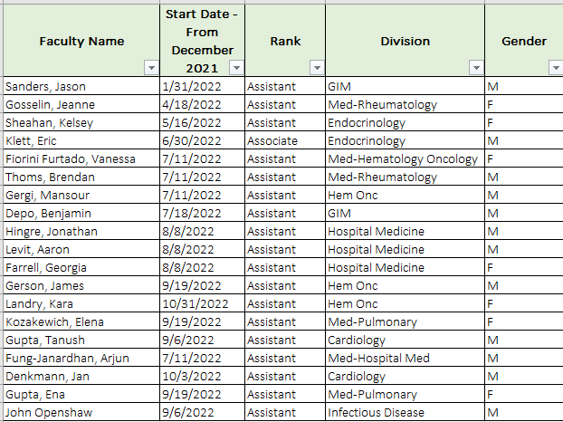
Welcome New Faculty

Slide 4
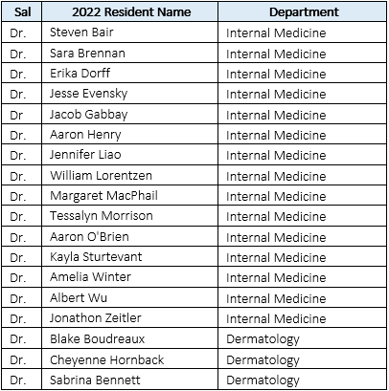
Welcome Incoming Residents

Slide 5
Preliminary
Dr. Ethan Bent - Radiology
Dr. Sheridan Joseph - Dermatology
Dr. Claudia Russell – PM&R
Preliminary Neurology
Dr. Samantha (Sam) Blum
Dr. Callie Brown
Dr. Taylor Lakusta-Wong
Dr. Adam Morehead
Dr. Sabrina Wirth
Preliminary Anesthesia
Dr. Alisha Booms
Dr. Sarah “Sally” Clark
Dr. Ryan Dwosh
Dr. Christopher Frederick
Dr. Jefferson Last
Dr. Anna Quinlan

Slide 6
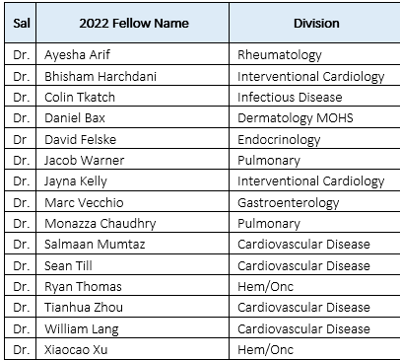
Welcome Incoming Fellows

Slide 7
Department of Medicine Faculty Awards
June 10, 2022

Slide 8
Distinguished Clinician Award
Objective: To recognize outstanding clinicians in our department
Award Criteria: Our most accomplished and widely-recognized practicing physicians will be selected based on their recognition as an outstanding clinician, reputation as a "physician's physician," and their exceptional contributions in education, scholarship, administration or community service
Selection: DOM Faculty Development Committee

Slide 9
Distinguished Clinician Award
Nominees
Kemper Alston (Infectious Disease)
Dennis Beatty (Gen Intern Med)
Zail Berry (Geriatric Medicine)
Maria Burnett (Hospital Medicine)
Garth Garrison (PCCM)
Glenn Goldman (Dermatology)
Naomi Hodde (Hospital Medicine)
Alana Nevares (Rheumatology)
Lou Polish (Infectious Disease)
Joel Schnure (Endocrinology)
Tim Whitman (Infectious Disease)
Joe Winget (Cardiology)

Slide 10
Distinguished Mentor Award
Objective: To reward the often overlooked but pivotal role mentors play in future and current careers
Award Criteria: Nominees may be considered for any of the following mentorship roles:
Clinical Resident or Fellow Mentor
Faculty Mentor
Graduate Student or Post-Doctoral Fellow Mentor
Selection: The Department of Medicine Research Committee

Slide 11
Distinguished Mentor Award
Nominees
Molly Barry (Heme-Onc)
Jason Botten (Immunobiology)
Garth Garrison (PCCM)
Amanda Kennedy (Hospital Medicine)
Richard Pinckney (Gen Intern Med)

Slide 12
Meritorious Service Award
Objective: To recognize faculty who have demonstrated outstanding service over the past year
Award Criteria: Candidates will be selected based on the basis of exceptional service and citizenship to the department, medical center, college, community, and/or profession over the past year
Selection: The Department of Medicine Vice Chairs Committee

Slide 13
Meritorious Service Award
Nominees
Gil Allen (PCCM)
Kemper Alston (Infectious Disease)
MaryEllen Antkowiak (PCCM)
Ralph Budd (Immunobiology & Rheumatology)
Kim Dittus (Heme-Onc)
Zech Gardner (Hospital Medicine)
Bonnie Libman (Rheumatology)
Carrie Lyon (Hospital Medicine)
Cindy Noyes (Infectious Disease)
Laura Paxton (Rheumatology)
Jeffrey Rimmer (Nephrology)

Slide 14
Quality Scholarship Award
Objective: To recognize faculty and/or faculty-led teams in the Department of Medicine (DOM) who have demonstrated excellence in scholarly quality improvement, patient safety, or high value care
Award Criteria: Candidates will be selected based on their leadership in improving the quality, safety, or value of care for patients utilizing rigorous and scholarly approaches, with dissemination of the findings through presentation and/or publication
Selection: The Department of Medicine QA&I Committee

Slide 15
Quality Scholarship Award
Nominees
Melanie Bui (Dermatology)
Eric Ganguly (Gastroenterology)
Chris Holmes (Heme-Onc)
Charlotte Teneback (PCCM)
Tim Whitman (Infectious Disease)
Notes:
Presented by:

Slide 16

March 10,
2020

Slide 17
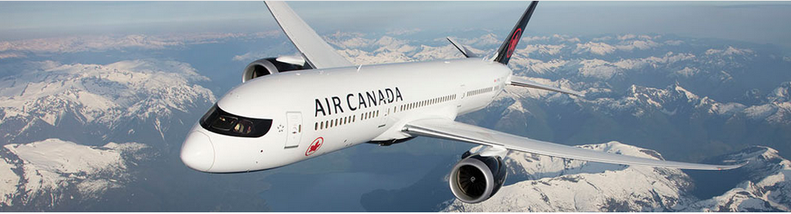
March 12, 2020

Slide 18
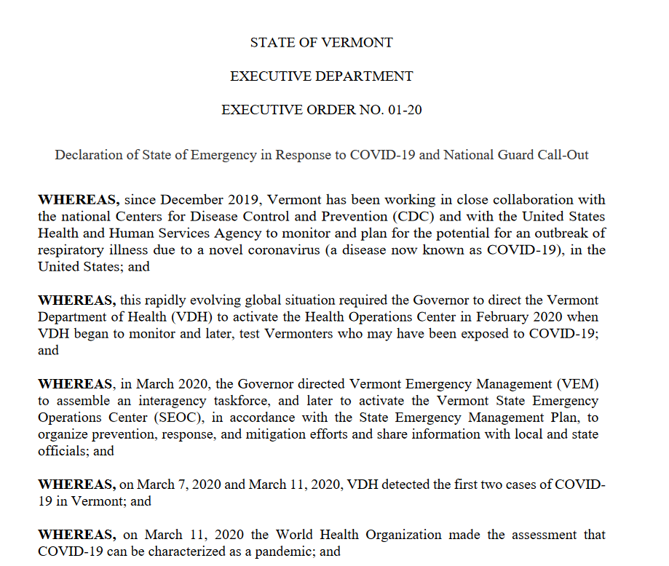
March 13, 2020

Slide 19
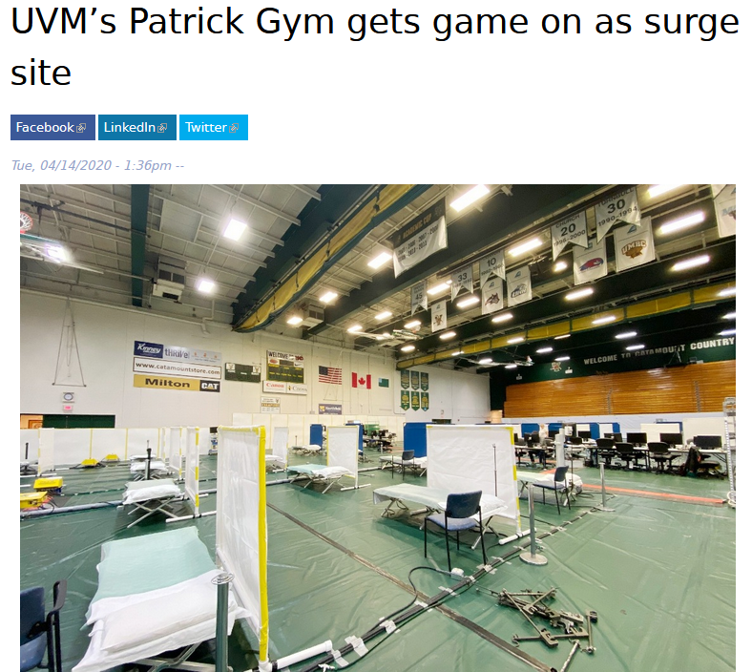
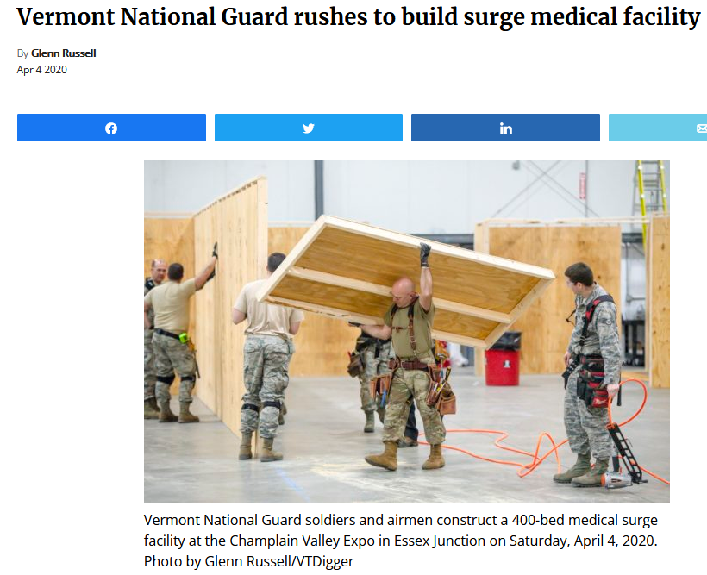
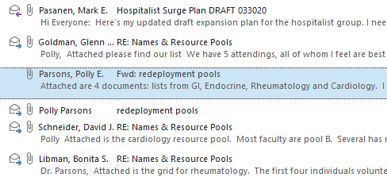
April 4, 2020
Sunday March 22, 2020: DOM
Succession plans for all leaders complete
Four deep coverage plan complete
April 4, 2020
March 30, 2020: Hospital Surge Plan Coverage

Slide 20
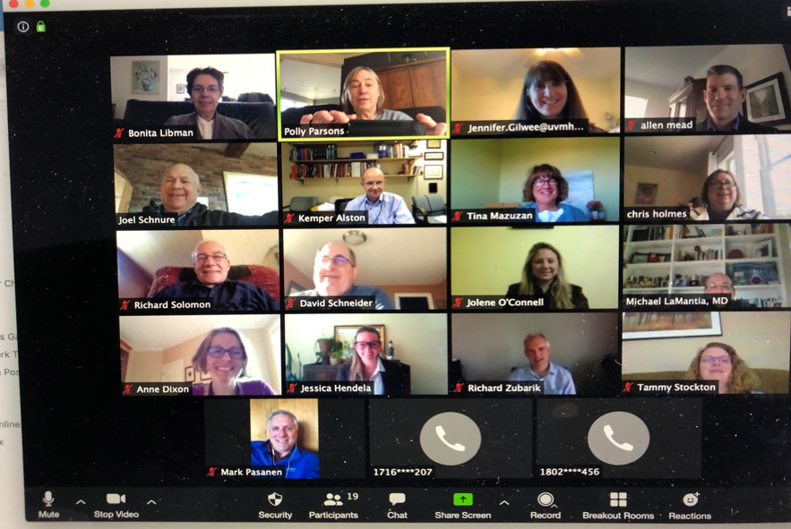
And Zoom Became the New Normal

Slide 21
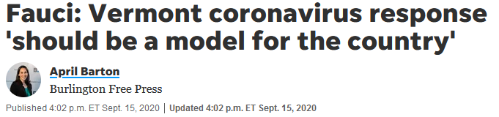


Slide 22


Slide 23
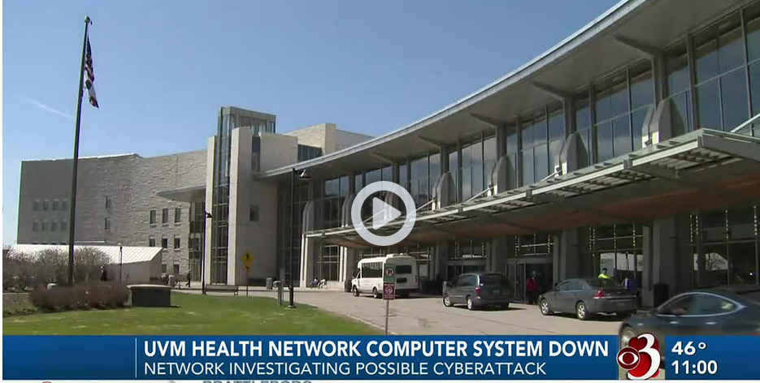
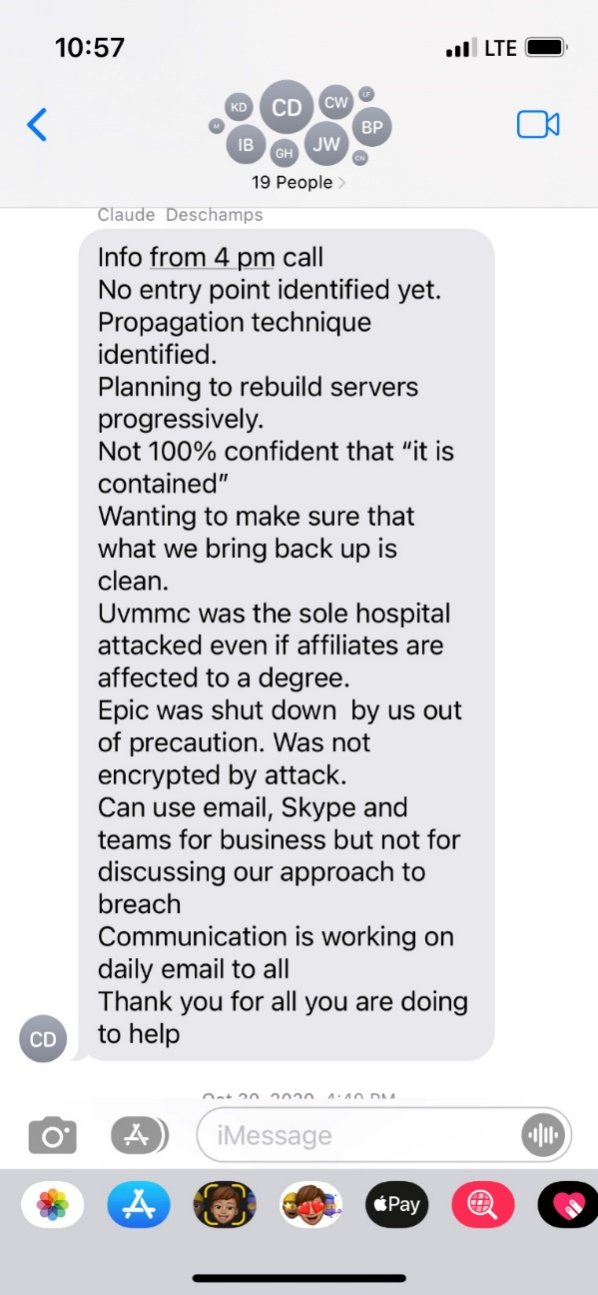
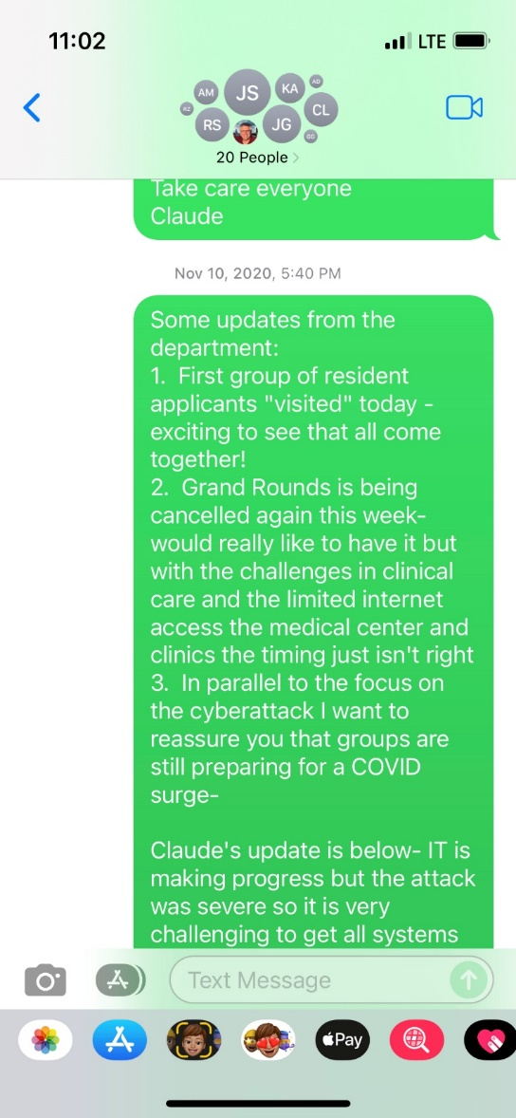
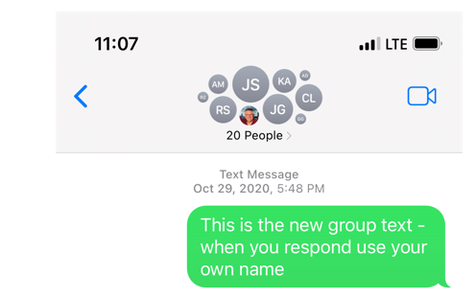
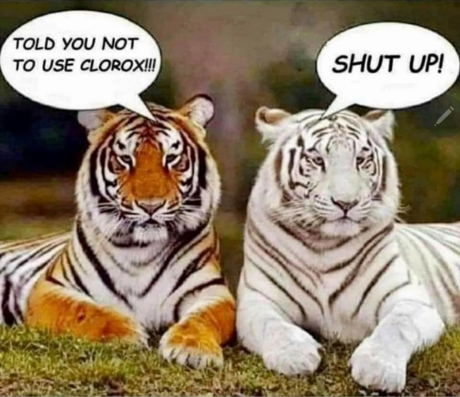
October 28, 2020

Slide 24
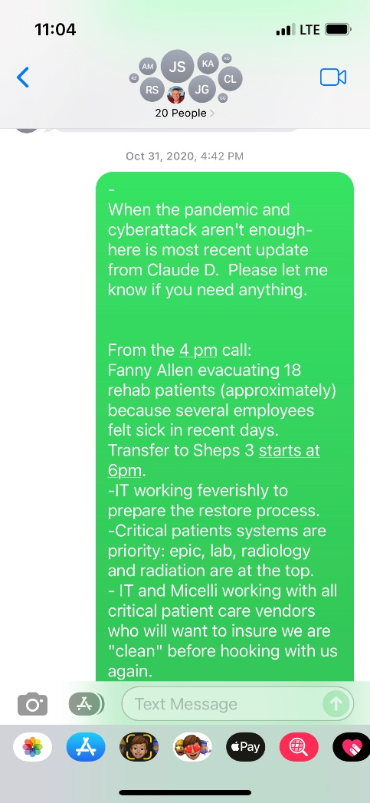
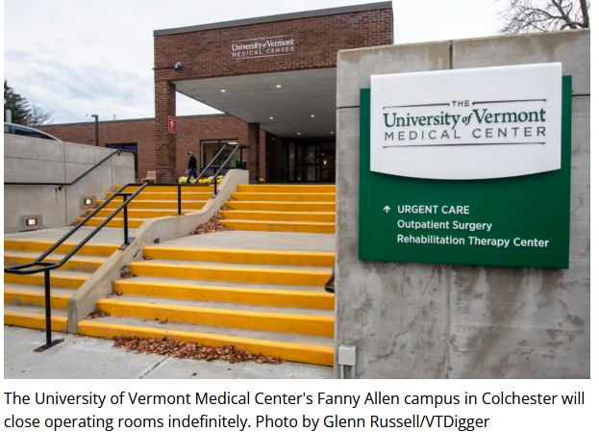
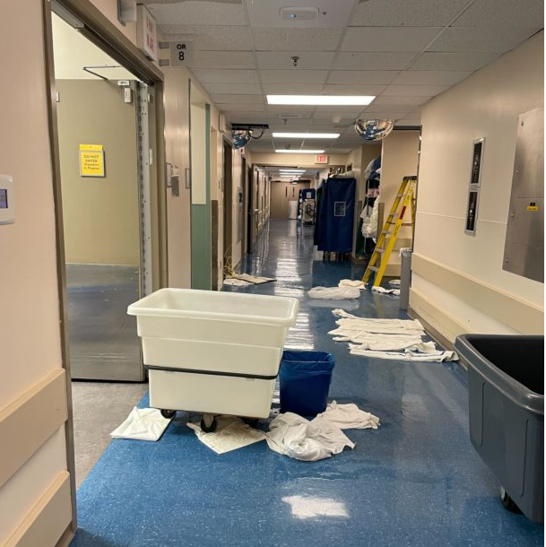
Oh yeah, and that happened……..
October 31, 2020
November 12, 2020
FA OR Shutdown
April 4, 2022
ORs Flood

Slide 25
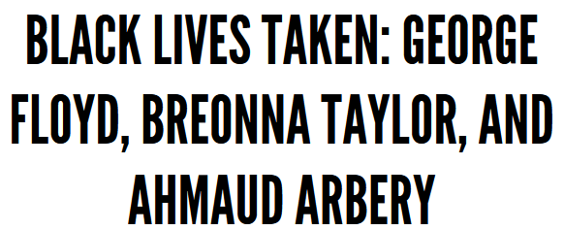
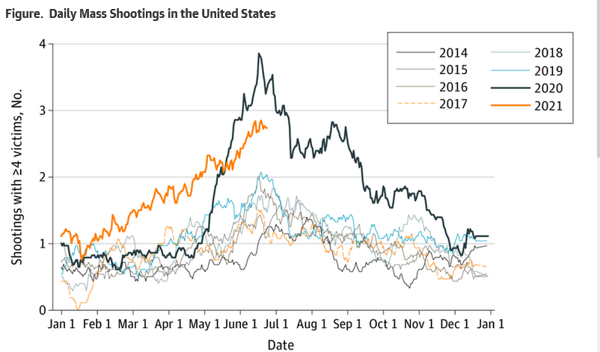
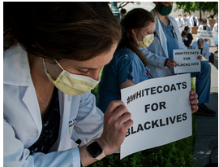
Outside Our Own Walls
Mass Shootings in US
June 16, 2020

Slide 26
DOM Meeting December 2021
Looking forward to 2022!

Slide 27
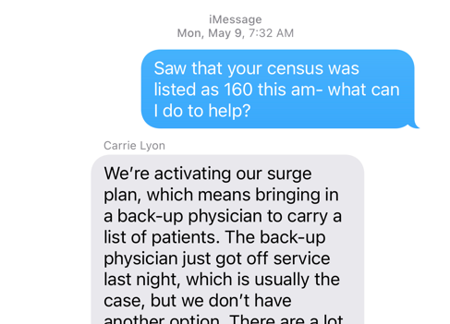
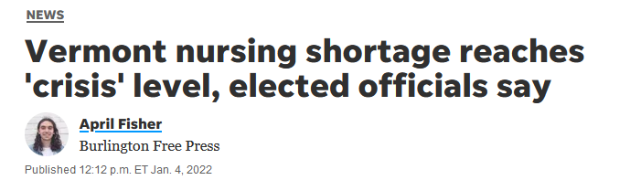
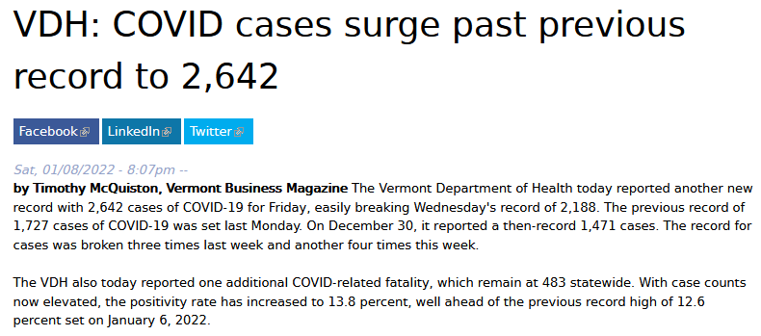
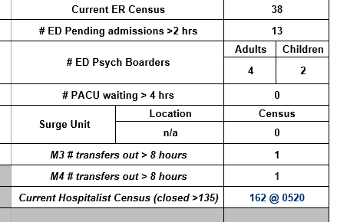

Slide 28
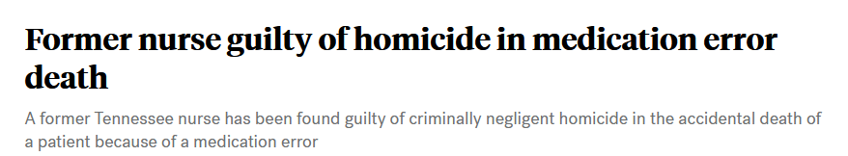
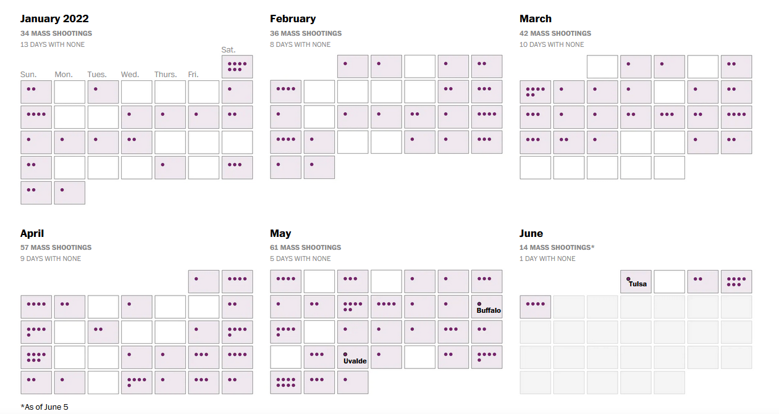
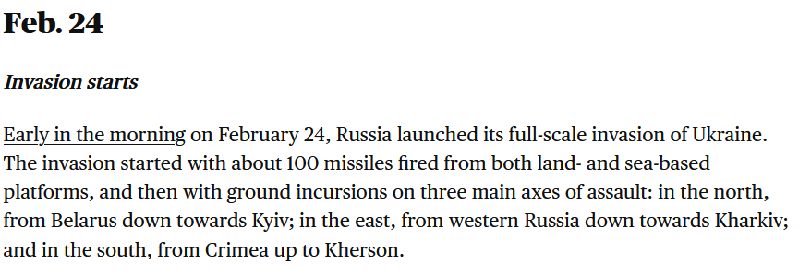
Russia invades Ukraine 2022

Slide 29
Department of Medicine
June 2022
Growing and continuing to “punch above its weight”
But ……tired.

Slide 30
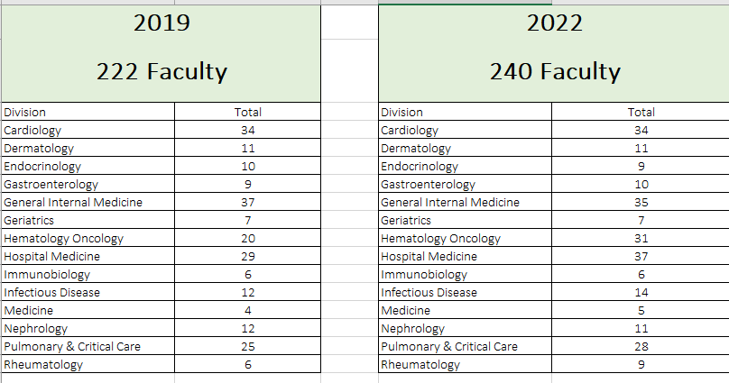
Who Are We?

Slide 31
Recruitment and Retention

Slide 32
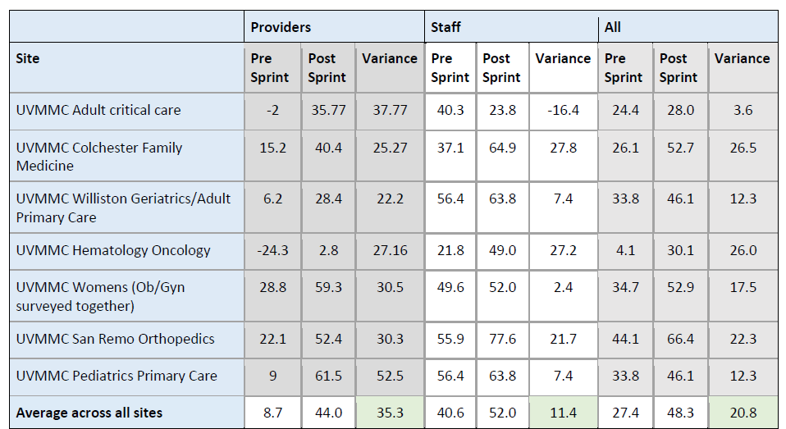
EPIC Sprint Program
Started in DOM: GIM and ID

Slide 33
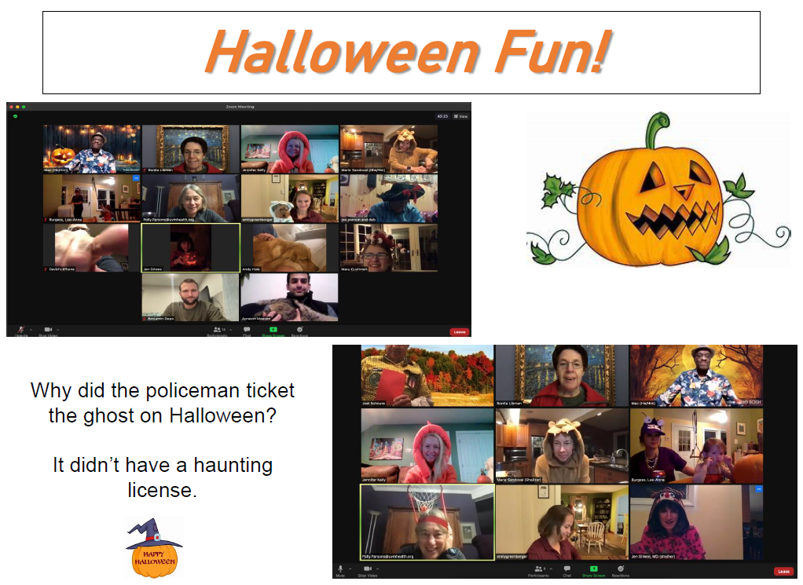

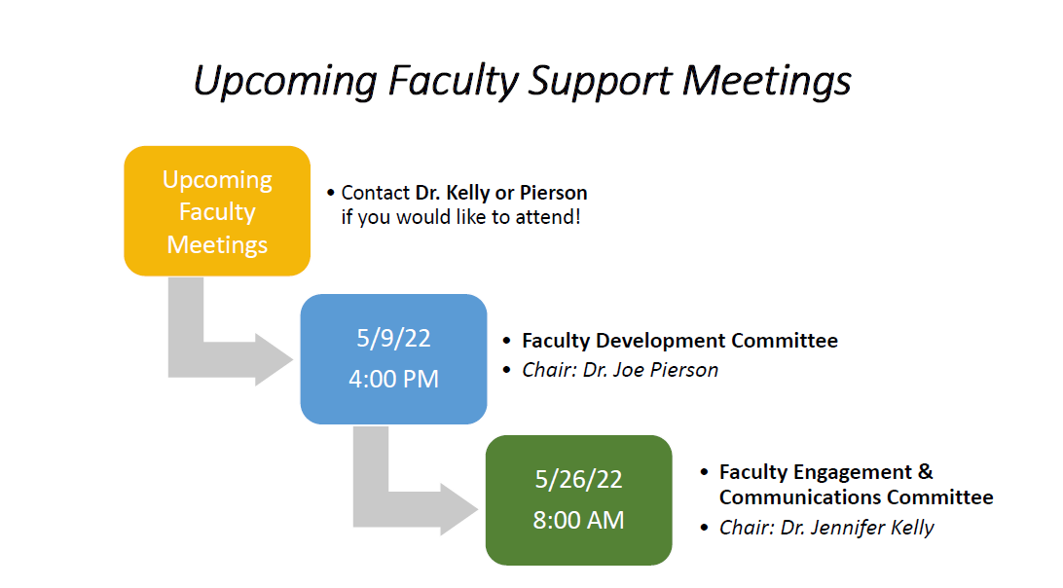
Faculty Development and Faculty Engagement Committees:
DOM Gender Equity Group
DOM DEI Committee
DOM Mentorship
Program

Slide 34
Gender Equity Group, DOM
Drs. Emily Greenberger, Kristen Pierce, Jennifer Kelly, Sherrie Khadanga, Rachel McEntee, Katherine Menson, Halle Sobel, Doris Strader, Emily Strout and Elizabeth Wahlberg
Spring Grand Rounds: Review of Gender Equity in Academic Medicine
DOM Gender Equity Survey Results
June 6 Presentation at the LCOM Gender Equity Meeting
Networking and social event for all in August, Stay tuned…

Slide 35
DOM DEI COMMITTEE
Macaulay Onuigbo- Co-Chair
Marie Sandoval- Co-Chair
Katie Menson- Assoc Program Director, IM Residency
Dragos Banu
Diane Haddock
Naomi Hodde
Mohit Jindal
Jennifer Kelly
Carolyn Morris
Kristen Pierce
Bonita Libman
Shreya Amin- departing 6/2022
Ben Depo-transitioning 6/2022

Slide 36
DOM DEI work groups
Subgroups of this committee
1. Vision: Education, DEI department plans
2. People: Pipelines to develop change
3. Data: Collecting, synthesizing, assessing metrics of our changes

Slide 37
DOM DEI committee
Please let us know if you are a resident or fellow who is interested in joining our committee.
Please do not hesitate to contact us.
We meet once a month.
The subgroups have started working on the different strategies and methodologies to achieve the committee goals and objectives.
The committee reports directly to the Chair, Department of Medicine, and is working in collaboration with the LCOM Dean’s Advisory Committee on Diversity, Equity & Inclusion.

Slide 38
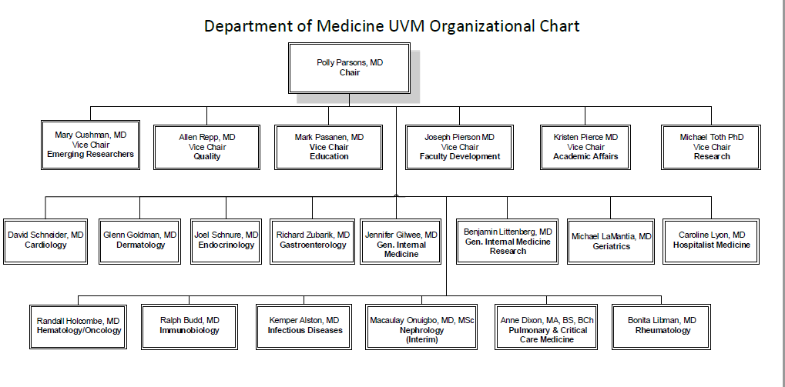
Our Team

Slide 39
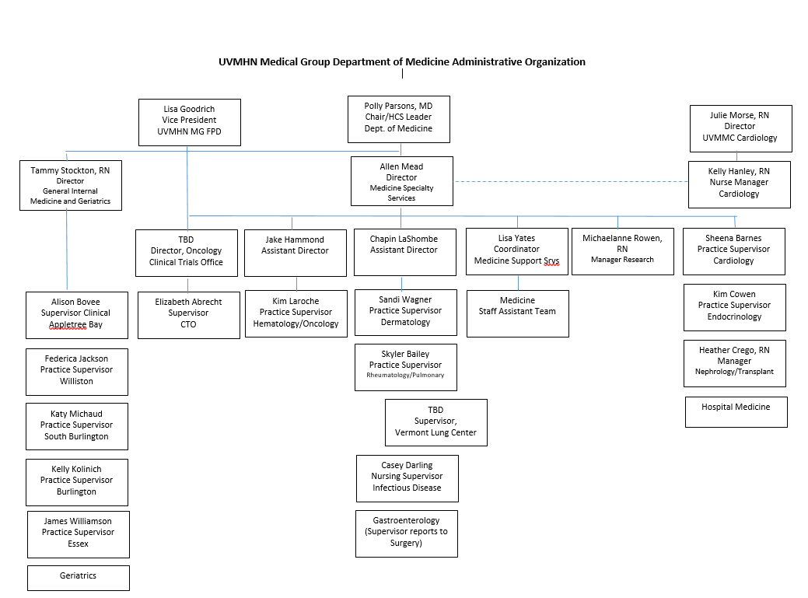

Slide 40
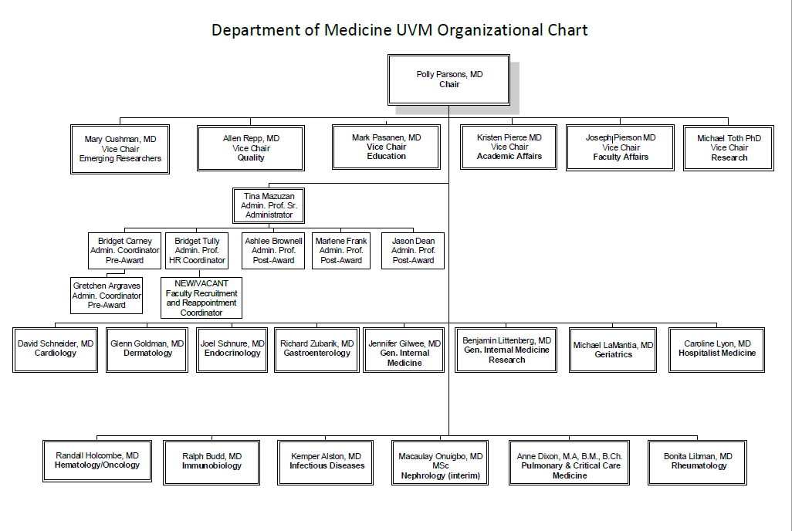

Slide 41
How We Spend Our Time

Slide 43
Clinical Care
 | April Actual | April Budget | Variance | YTD Actual | YTD Budget | Variance
RVU | 56,808 | 54,566 | 4% | 474,677 | 418,720 | 13.40%
Clinical Sites Local:
UVMMC, UHC, Tilley Drive, Fanny Allen, South Burlington, Essex, Williston, The Arbors, Birchwood, Green Mountain,
Clinical Sites Outreach:
Vermont: Brattleboro MH, Northwestern, Northeastern, CVMC, Rutland, Porter, Newport
New York: Massena, CVPH,

Slide 44
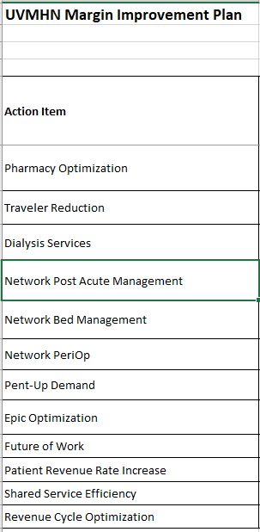
Network Financials

Slide 45
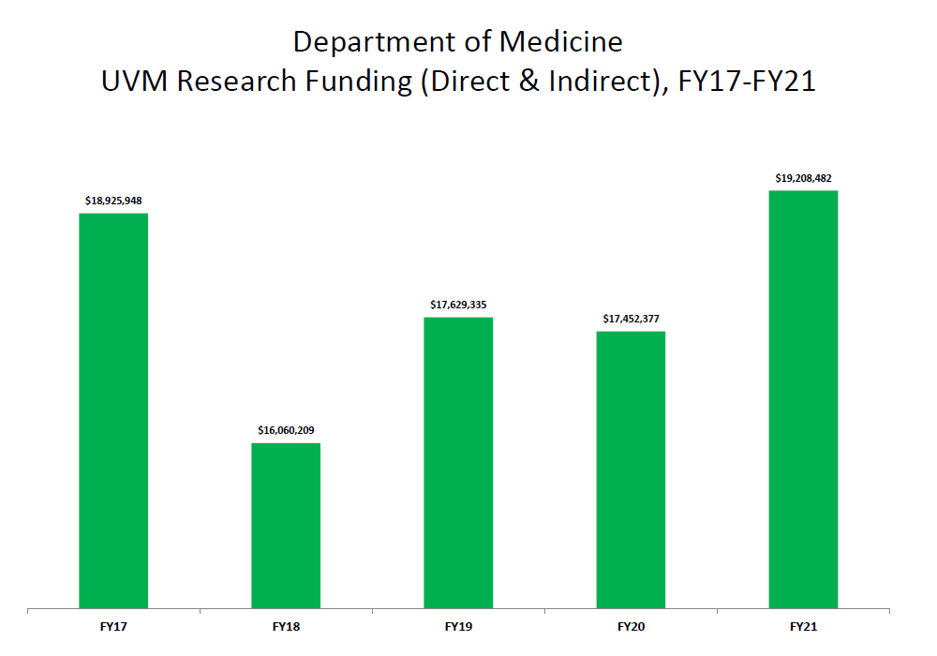
Research

Slide 46
Department of Medicine and LCOM and UVM
13% of total UVM applications, 22% total LCOM applications
15% total active UVM awards, 26.5% total active LCOM awards
>150 active IRB protocols
> $3 million UVMMC research

Slide 47
Education
Undergraduates
Graduate students
MPH program
Medical Students: throughout all four years
Clinical Clerkships:
In patient
Out patient
Acting Internship
Residents: Internal Medicine and Dermatology
Fellowships: 10 programs

Slide 48
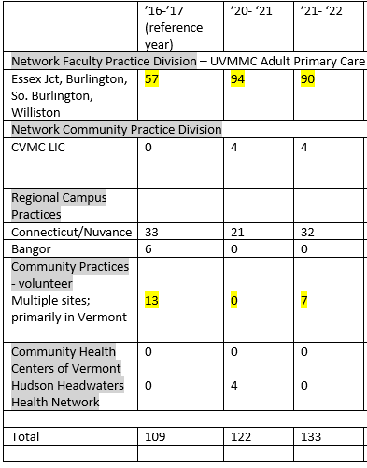
Outpatient IM Clerkship
In Patient IM Clerkship
2019: 8-9 students/block
2021: 12-14 students/block
Acting IM Internship
2019-2020
UVMMC Med AI - 67
  44 general medicine
  11 cardiology
  12 hematology/oncology
UVMMC MICU AI – 22
  No MICU night float
2021-2022 (scheduled)
  UVMMC Med AI- 113
    45 general medicine services
    36 Cardiology/medicine hybrid
    32 hematology/oncology
  UVMMC MICU AI -21
    PLUS 7 MICU-NF

Slide 49
Recognition
Anne Dixon: University Scholar
Allen Mead: Elected Treasurer, AAIM
Class of 2022 Honors night:
David Kaminsky: Clinical Teacher of the Year
Tim Lahey: Leonard Tow Humanism is Medicine
Dept of Medicine: nominated for 2022 Clinical Dept of the Year
Ali Jandal: Resident of the Year
Ali Jandal and David Steinmetz-AOA housestaff awardees

Slide 50
DOM Resident Graduation June 2022
Faculty Awards:
Mark A. Levine General Medicine Teacher of the Year Award: Emily Greenberger
E.L. Amidon Subspecialty Teacher of the Year Award: Bill Hopkins
Description of Resident Awards:
Harriet P. Dustan Research Award: Christina He
Richard E. Bouchard Primary Care Excellence Award: David Steinmetz
Frank L. Babbott Memorial Award: Jamie Rowell

Slide 51
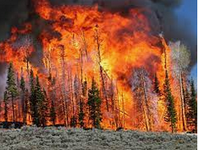
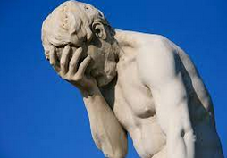


Zoom Background Options
2020-2022

Slide 52

The Best Zoom Background
Thank you!

