Slide 1
Department of Medicine
December 17, 2021

Slide 2
Two Slides From the Past……….

Slide 3
Department of Medicine 2019

Slide 4
Thank you, everyone. Happy Holidays Looking forward to 2020!

Slide 5
2020 is way back in our rear view mirror-and 2021 is about to be….and despite a cyberattack, a pandemic and “oh yeah, that happened” it has been a year of accomplishments

Slide 6
Faculty Name | Division | Start Date
Poston, Jacqueline | Med-Hematology Oncology | 4/19/2021
Kaminski, Peter | Med-Hospital Med | 6/2/2021
Khan, Shamima | Med-Medicine - Eduprenuership | 7/1/2021
Bullis, Sean | Med-Infectious Disease | 7/12/2021
Holcombe, Randall | Med-Hematology Oncology | 8/1/2021
Suggs, Lauren | Med-Cardiology | 8/9/2021
Kokoszynska, Marta | Med-Pulmonary | 8/9/2021
Heffley, Jason | Med-Gastroenterology | 8/23/2021
Rand, David | Med-Hospital Med | 9/7/2021
Morris, Carolyn | Med-Pulmonary | 9/7/2021
Greenberg, Caitlyn | Med-Hospital Med | 10/1/2021
Banu, Dragos | Med-Gen Internal Med | 11/15/2021
Koulouris, Carolyn | Med-Gen Internal Med | 11/15/2021
Marineci, Silviana | Med-Nephrology | 12/13/2021
Gosselin, Jeanne | Med-Rheumatology | 4/18/2022
Klett, Eric | Med-Endocrinology | 6/30/2022
Fiorini Furtado, Vanessa | Med-Hematology Oncology | 7/11/2022
Thoms, Brendan | Med-Rheumatology | 7/11/2022
Gergi, Mansour | Med-Hematology Oncology | 7/11/2022
Ducomb, Emily | Med-Pulmonary | 8/9/2022
Welcome New Faculty! *
*Look for the next edition of
The Chart!!!

Slide 7
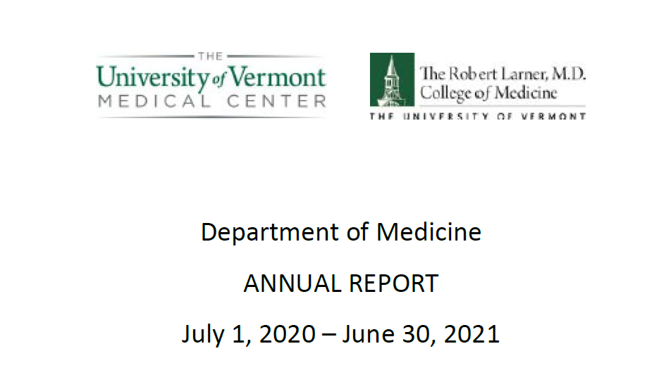

Slide 8
Recognition-a few highlights
Josh Farkas: Gold Foundation Champions in Humanism Award
Jason Bates: American Thoracic Society Recognition for Scientific Accomplishment
Glenn Goldman: President, American College of Mohs Surgery
Mary Cushman: American Heart Association Award of Meritorious Achievement
Randy Holcombe: Inaugural J. Walter Junkett Chair in Cancer Research
Kristen Pierce: Vermont Medical Society Physician Award for Community Service
Tim Plante: Bloomfield Early Career Professorship in Cardiovascular Research
Halle Sobel: Distinguished Educator, LCOM Teaching Academy

Slide 9
9th Biennial Stem Cell Conference: Dan Weiss
UVM MPH earned national accreditation: Jan Carney
LCME reaccreditation for 8 years: Everyone!!
Clinical mission: 665,733 RVU (2% above budget)
And all the accomplishments to follow…

Slide 10
Department of Medicine: Research Update
December 17, 2021

Slide 11
Agenda
State of Research Funding
Dept of Medicine Research Committee
Research Funding Opportunities
New Research Resources
Translational Medicine Awards (Winter ‘22)
Early Career
Green and Gold Early Professorship (Spring ’21)
Early Career Research Committee (Fall ‘21)
Wohlgemuth Fellowship (Fall ’21)

Slide 12
Research Applications (Dec 2020)
Mar-Dec
2019
90 applications
$21,648,145
Mar-Dec
2020
95 applications
$31,916,608

Slide 13
Department of Medicine UVM Research Funding (Direct & Indirect), FY17-FY21

Slide 14
Department of Medicine UVM Medical Center Research Revenue (Direct & Indirect), FY17-FY21

Slide 15
Research Committee
With faculty and staff representation from across the Department, the Committee serves the research mission of the department by developing and reviewing strategic objectives, policies and procedures to support research activities of our faculty, creates/reviews pilot funding opportunities, facilitates communication about research opportunities and information across the department and support early and junior faculty with research mentorship.

Slide 16
UVM Funding Opportunities Announcement
UVM Announcements
Broader Announcements (NIH)
Professional Development
Limited Competitions
Grad Student Opportunities
Large Grant Opportunities
Featured Opportunities
Pivot – Curated Searches
16

Slide 17
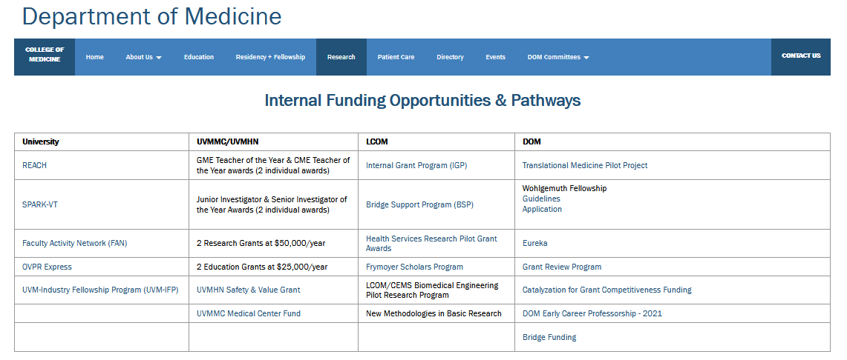
Translational Medicine Pilot Grant Program
http://www.med.uvm.edu/medicine/dom-research/internal-funding-opportunities-and-pathways

Slide 18
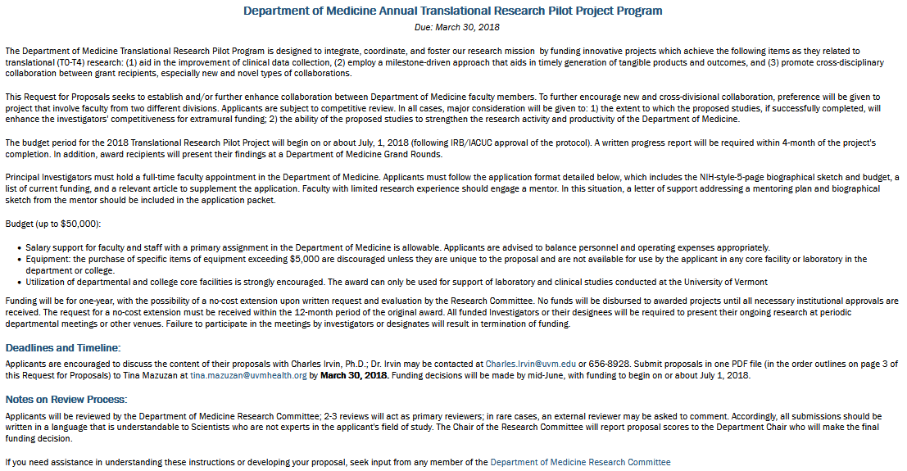
Translational Medicine Pilot Awards

Slide 19
Agenda
State of Research Funding
Dept of Medicine Research Committee
Research Funding Opportunities
New Research Resources
Translational Medicine Awards (Winter ‘22)
Early Career
Green and Gold Early Professorship (Spring ’21)
Early Career Research Committee (Fall ‘21)
Wohlgemuth Fellowship (Fall ’21)

Slide 21
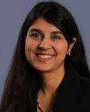
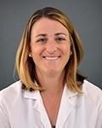
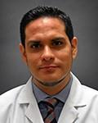
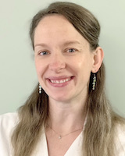
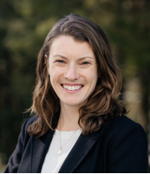
Early Career Research Committee
Sherrie Jessica Diego Nicole Kelsey
Khadanga Badlam Adrianzen Habel Gleason
MD MD MD MD, PhD ScD
Cardiology Pulmonary Heme Onc Cardiology Public Health

Slide 22
DOM Green and Gold Early Career Professor
Goal: Encourage and support an early-stage independent investigator
in research
What: UVM Professorship
Who: Faculty within 5 years of their first faculty appointment
How Much: $10,000/year for 2 years
When: March 15, 2021 Letter of intent due
April 1, 2021 Notification of acceptance of letter
June 1, 2021 Applications due
August 2021 Announcement of recipient

Slide 23
Recipient, Green and Gold Early Career Professor
Diego Adrianzen Herrera
Assistant Professor
Hematology Oncology Division
Identifying Patient and Treatment Factors Associated with Cardiovascular Disease Risk and Mortality in Myelodysplastic Syndromes
Investiture January 12 at 11:00

Slide 24
Are you doing heart-related research??

Slide 25
Wohlgemuth Fellowship
Why: competitiveness for extramural funding and research productivity
Who: DOM postdoctoral & clinical fellows, assistant professors in first 5 years, or associate professors initiating a research program for the first time
Eligible Science: Causes, epidemiology, prevention, diagnosis, and treatment of heart disease.
Details: $40,000 over 2 years. Funds may support salary for faculty, staff and/or trainees, essential equipment and other study related expenses.
Dates: LOI Jan 1. Due Date Feb 2.
Application Review Information Competitive review by Research Committee

Slide 26
Wohlgemuth Fellowship
http://www.med.uvm.edu/medicine/dom-research/internal-funding-opportunities-and-pathways
26

Slide 27
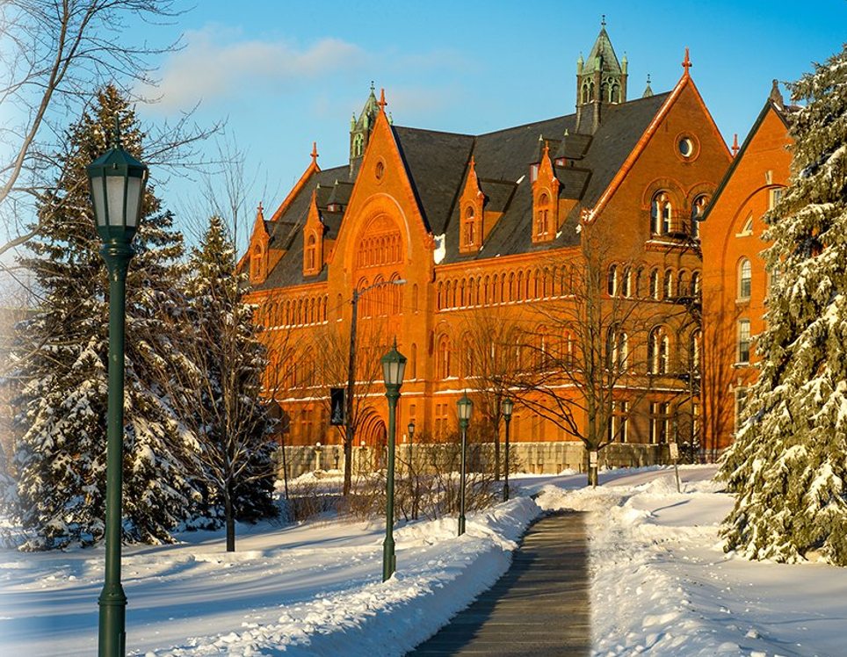
Calling early career researchers in the DOM!
Please contact me if I can assist you

Slide 28
Faculty Development Mentoring Teaching Academy opportunities Annual review The early to late career spectrum

Slide 29
Looking forward to 2022!

