Slide 1
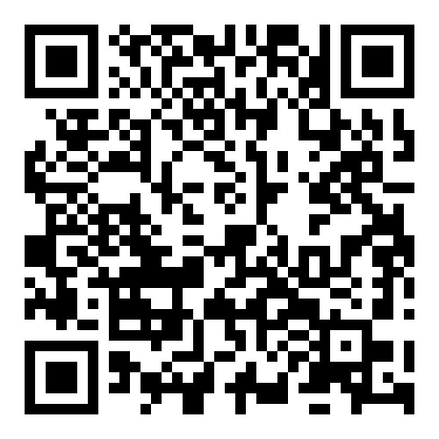
CENTER ON AGING
THE UNIVERSITY OF VERMONT LARNER COLLEGE OF MEDICINE
CONNECTING GENER ATIONS
TO ENRICH AGING IN VERMONT
Advance the science of aging and longevity research at UVM!
Are you interested in studying Quality of Life of Older Vermonters, Aging in rural areas, Innovations in healthcare communication with older adults, Caregiving and aging, Resilience and longevity in Vermonters?
Apply for the UVM Center on Aging Pilot Grant Award!
Applications due April 30th, 2024.
Funds up to $75K will be awarded July 1, 2024. Details
including evaluation criteria are available: https:// uvm.infoready4.com/#competitionDetail/1929196
Center on Aging | UVM Larner College of Medicine
802-656-0292 | aging@uvm.edu | med.uvm.edu/centeronaging Courtyard at Given, N208 | 89 Beaumont Avenue | Burlington, VT 05405

