Slide 1
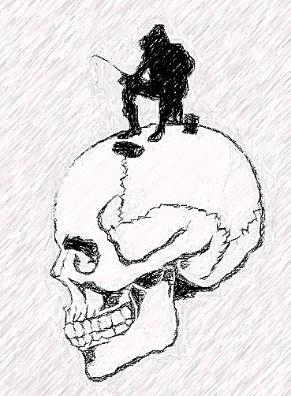
NENS
New England Neurosurgical Society
Objectives:
The workshop is designed to provide and enhance practical knowledge of various approaches to the skull base. Neurosurgeons and otolaryngologists will participate in didactic and hands-on sessions to facilitate this working knowledge. The course will cover minimally invasive and endoscopic approaches to the skull base, in addition to traditional approaches. At the conclusion of the course, the participant will have a comprehensive understanding of skull base approach options and an understanding of approach selection.
Design:
This is a three-day, hands-on workshop. The facility is state of the art and equipped with endoscopic towers and instrumentation, high speed drills, and microscopes. There will be two participants at each of eight stations.
Surgical Approaches to the Skull Base
A Hands-On Cadaver Workshop
Sponsored in part by New England Neurosurgical Society
February 22-24, 2024
General Information
Hotel Accommodations
Doubletree by Hilton (next to UVM)
870 Williston Road
South Burlington, VT 05403
802-865-6626
Surgical Approaches to the Skull Base A Hands-On Cadaver Workshop for Neurosurgeons
Workshop Location
RM Peardon Donaghy Microvascular and Skull Base Lab – University of Vermont, Larner College of Medicine
89 Beaumont Ave., Given Bldg. E302
Burlington, VT 05405
Airport
Burlington International Airport (BTV) is 10 minutes from the Skull Base Lab.
R.M. Peardon Donaghy Microvascular and Skull Base Lab
February 22-24, 2024
R.M. Peardon Donaghy Microvascular and Skull Base Laboratory University of Vermont

Slide 2
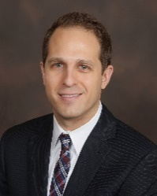
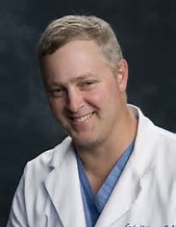
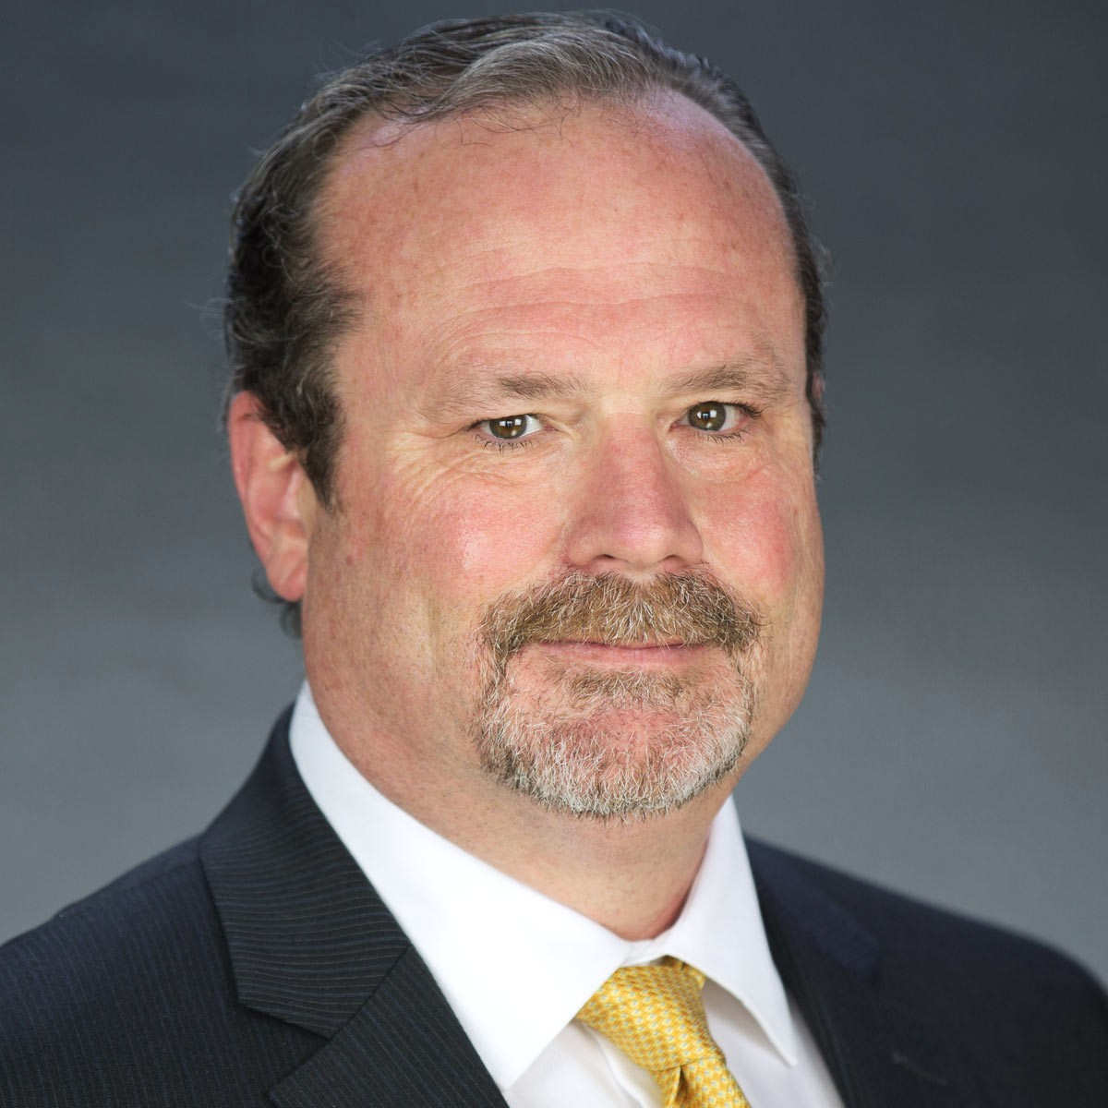
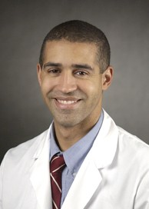
Course Director
Schedule and Lectures:
Friday, February 23, 2024
Brandon D. Liebelt, MD Assistant Professor Neurological Surgery University of Vermont Larner College of Medicine
Thursday, February 22, 2024
7:00-7:40
Temporal Bone Anatomy and Mastoidectomy Technique
George Kurien, MD
HSRF 300, Breakfast served
7:30-8:30
Grand Rounds
Johnny Delashaw
Davis Auditorium,
UVMMC Campus
“Complex Aneurysms and Skull Base Surgery”
7:40-8:20
Posterior Petrosal approach to Posterior and Middle Fossa
Sean McMenomey, MD
HSRF 300 Breakfast served
Special Guest Instructors:
8:50-9:20
Endoscopic Anatomy of the Sinonasal Cavity and Anterior Skull Base Carolyn Orgain, MD
HSRF 300
Carl Heilman, MD
Neurosurgeon-in-Chief
Professor and Chairman Neurosurgery Tufts New England Medical Center
8:20-12:00
Dissections - Mastoidectomy and Posterior
Petrosectomy
Skull Base Lab Given E302
9:20-10:00
Endoscopic Approaches to the Anterior Cranial Fossa
William Curry, MD
HSRF 300
1:00-5:00
BBQ and Ice fishing
**New location
Lake Iroquois Boat Ramp
94 Beebe Ln, Williston, VT
Sean O. McMenomey, MD
Professor Division Director Otology/Neurotology/Skull Base Surgery New York University
10:00-1:00
Dissection: Endoscopic Endonasal Approaches
-identify key endoscopic anatomy
-elevation of nasoseptal flap
-transsphenoidal and extended approaches
Skull Base Lab, Given E302
Saturday, February 24, 2024
8:00-8:40
Case Presentations
Breakfast served
HSRF 300
1:00-1:30
1:30-1:50
1:50-2:30
Lunch and Case Presentations
William T. Curry, MD Professor Neurosurgery Harvard Medical School Mass General Hospital
Supraorbital Approaches
Brandon D. Liebelt, MD
HSRF 300
8:00-8:40
Anterior Petrosal Approach to the Petrous Apex/IAC
Sean McMenomey, MD
HSRF 300
Approach to the Paraclinoid Region and Cavernous Sinus (FTOZ and its variants) Carl Heilman, MD
HSRF 300
8:40-9:20
Far later approach to Posterior Fossa
Johnny Delashaw, MD
HSRF 300
Johnny Delashaw, MD Professor
Director of Skull Base Surgery
Tulane University, School of Medicine
2:30-5:00
Dissection: Endonasal and Anterolateral Approaches
-Transcribriform, transplanum, transclival EEA
-Eyelid/eyebrow craniotomy
-FTOZ
Skull Base Lab, Given E302
9:30-12:00
Dissection: Middle Fossa and Far Lateral Approaches
Course Faculty
Light Lunch, Debrief, Depart
UVM Neurosurgery
Bruce Tranmer, MD, Professor
UVM Otolaryngology
George Kurien, MD, Assistant Professor
Carolyn Orgain, MD, Assistant Professor
6:00-7:30
Cocktails and hors d’oeuvres with Exhibitors
Doubletree by Hilton
870 Williston Road
South Burlington, VT 05403
To Register:
Sheila Russell
Skull Base Laboratory Director 89 Beaumont Ave.
Given Bldg. D319E
Burlington, Vermont 05405 Sheila.Russell@uvm.edu
802-656-2257
7:30
Dinner with Exhibitors
Doubletree by Hilton
Resident Instructor
Luke Silveira, MD, Neurosurgery Resident

