Slide 1
Working with 2STLGBQ+ People
Grand Rounds UVM 10.13.2023
kell arbor (they/them), director of Health & Wellness
Notes:
Kim

Slide 2
Training Agenda
Identities 101
Inclusive language
Strength & resiliency
Welcoming spaces
Marginalization
Reflections

Slide 4
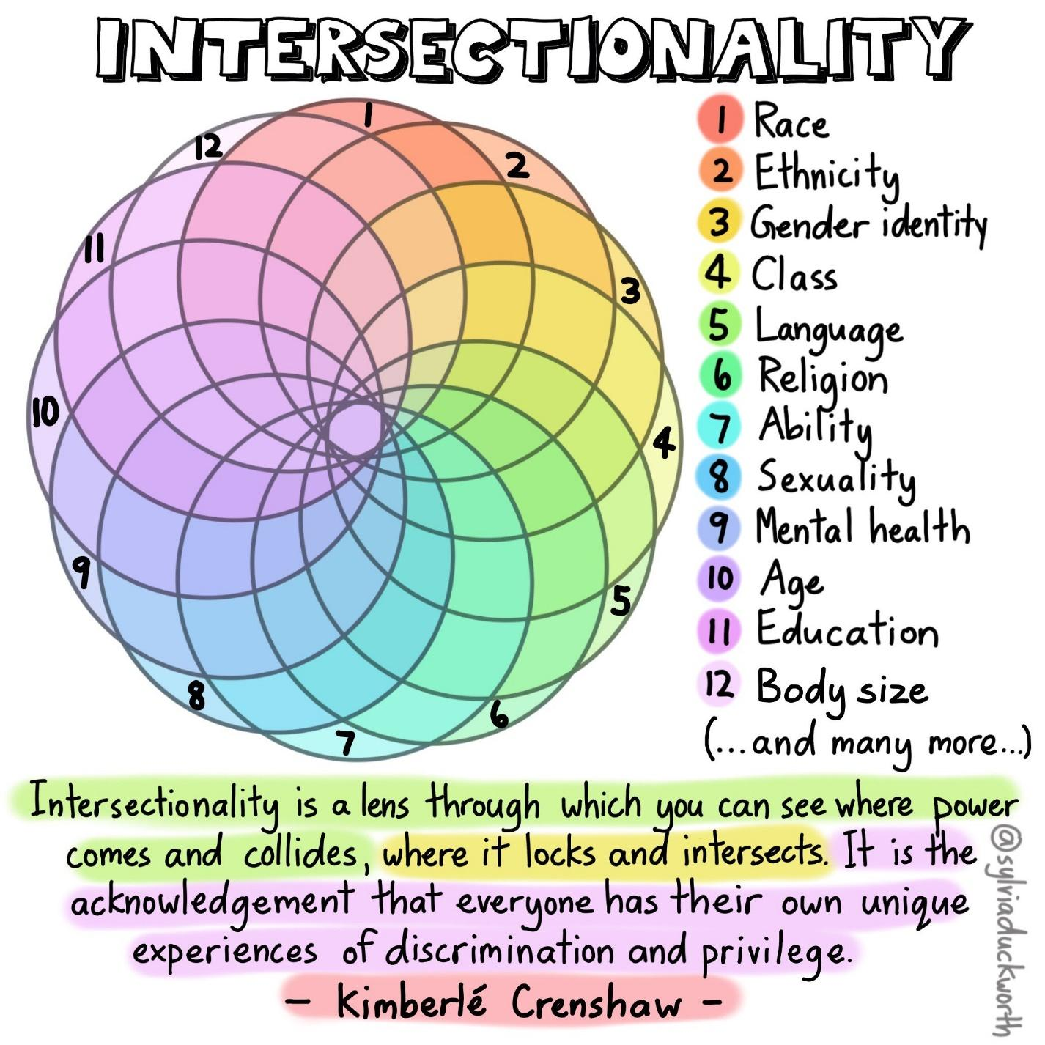

Slide 5
Identity Terms
How do we honor one another?
What if I don’t know what the term means?
How important are they?

Slide 6
Impacts of Marginalization
Stigma, prejudice, and discrimination create a hostile and stressful social environment that can ultimately cause mental health challenges.

Slide 7
Cultural Level
Discriminatory cultural beliefs & messages
e.g. “LGBTQ+ people are unnatural and wrong”
Institutional Level
Discriminatory practices & messages in laws, gov, business, media, church, healthcare, etc.
e.g. doctors being able to deny trans patients
Interpersonal Level
Harmful messages from family, friends, neighbors
e.g. being bullied
Individual Level
Believing you deserve the above because of your identity
e.g. “I’m worthless because I’m
queer”

Slide 8
Intent, Impact, & Accountability
Intent
is what we mean to do…
is how others experience what we do and how we do it…
is how we acknowledge our impact, regardless of our intent.
impact
Accountability

Slide 9
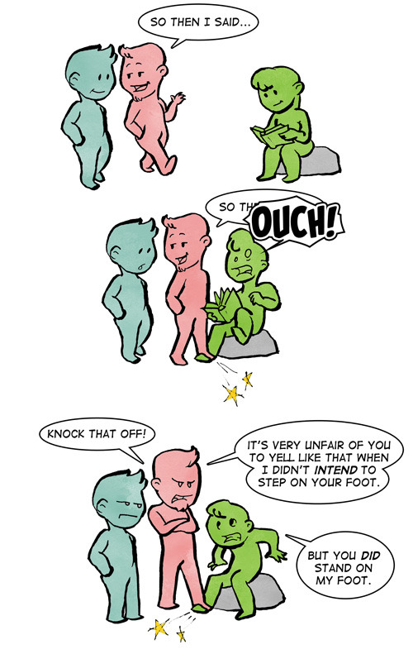
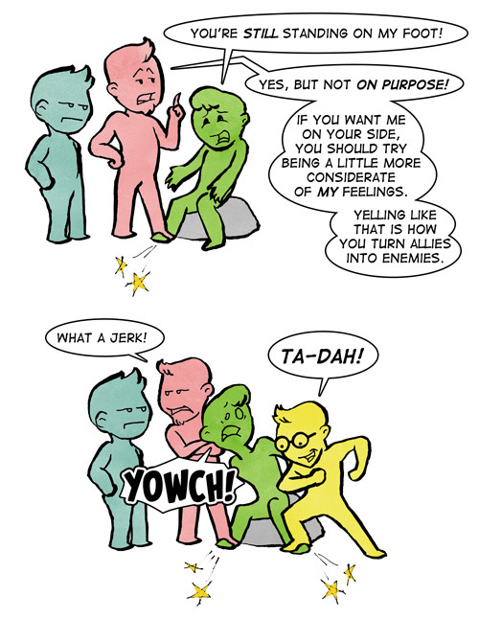
dovesherman.tumblr.com

Slide 10
What should you do when you make a mistake?
‘Raise your hand’ to share or type them into the chat.

Slide 11
Write out a list of gendered terms used at your organization.
EXERCISE

Slide 12
Share some of the words on your list with your group and brainstorm inclusive alternatives
EXERCISE: Break Out Rooms

Slide 13
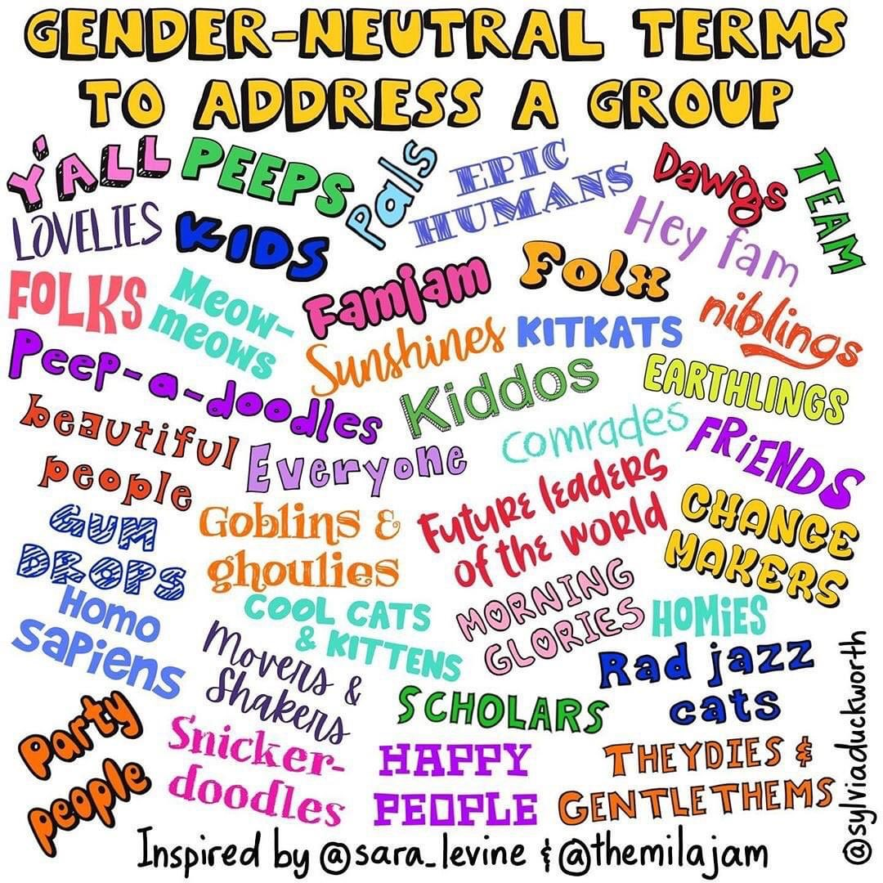
Inclusive Language
What gender-inclusive alternatives did your group come up with?

Slide 14
Tips for Creating a More Welcoming Workplace
Challenge your assumptions
Share your pronouns, and make space for others to share theirs
Embrace gender-neutral language and pronouns when referring to groups and individuals
When asking identity-related questions, first ask yourself “why?”
Try not to expect LGBTQ+ clients to educate you; seek resources
Be cautious of outing people
Believe people

Slide 15
Identify one action or practice that your office can take to make your workplace more affirming and inclusive to LGBTQ+ employees and clients
REFLECT & ACT

Slide 16
Pride Center of Vermont
Drop-in Resource Center
Community Social Events
Peer-led Support Groups
LGBTQ Disability Network
Health & Wellness Program
MPowerment Project
HIV Testing & PrEP/PEP
Tobacco Cessation
Cancer Screenings
SafeSpace Anti-Violence Program
Direct Service
Education
Systems Advocacy
Transgender Program
Trans Support Group
Transpire Committee
Resource Navigation
Notes:
Kim

Slide 17
Thank you for having us!
Lingering questions?
kell@pridecentervt.org
pridecentervt.org/education

