Slide 1
Medical Students at the Research Bench: Strategies for Effective Teaching in the Lab Christopher L. Berger, PhD Dept. of Molecular Physiology & Biophysics
2023 Snow Season Education Retreat

Slide 2
Part I: Identify the motivation, specific training needs and goals of the student.
2023 Snow Season Education Retreat

Slide 3
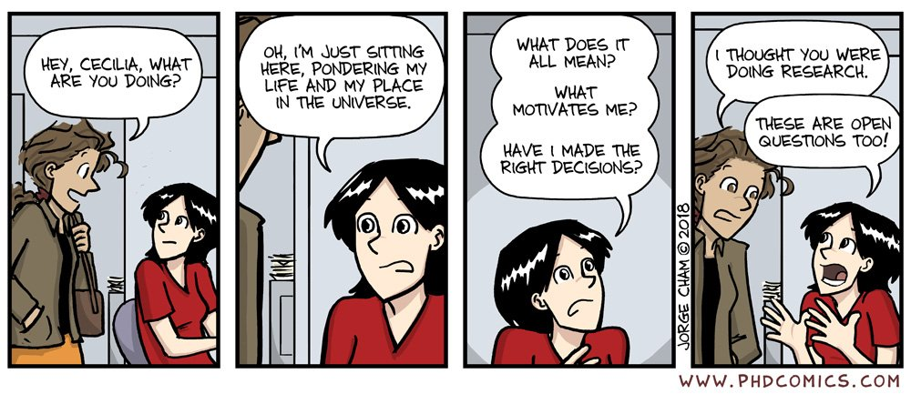
Why do a research project or experience?
Do research if:
You have a burning passion to discover something new.
You enjoy thinking and working independently.
You want to increase your ability to think critically and creatively.
You enjoy “hands-on” work.
Don’t do research:
Just because you think it will look good on your resume or an application.
If you don’t like to be intellectually challenged.
2023 Snow Season Education Retreat

Slide 4
Why do a research project or experience?
The right motivation to do research is a big part of how successful a research experience will be – but what else is required to set up a student up for a successful research experience?
2023 Snow Season Education Retreat

Slide 5
How do you set a motivated student up for success?
What are the student’s interests (i.e., what are the specific factors motivating the interest in research)?
What is the student’s background? It is especially important for a short research project that it build upon the student’s previous knowledge and training.
Strengths
Weaknesses
2023 Snow Season Education Retreat

Slide 6
How do you set a motivated student up for success?
What are the student’s interests (i.e., what are the specific factors motivating the interest in research)?
What is the student’s background? It is especially important for a short research project that it build upon the student’s previous knowledge and training.
What type of research does the student want to do?
Fundamental
Science
Translational
Science
Clinical
Science
Epidemiology
2023 Snow Season Education Retreat

Slide 7
Define the Goals of a Short Research Project
What do students want to get out of the research experience?
Do they want to:
answer a specific question or get exposure to the research process?
experience a particular type of research, field of study, or even specific laboratory?
learn a particular technique or set of techniques?
2023 Snow Season Education Retreat

Slide 8
Define the Goals of a Short Research Project
What type of project will best meet the both the goals of the student and the lab?
A complete research project?
A particular set of experiments that are part of a bigger project?
A standard experiment or set of experiments used to train people in the lab?
2023 Snow Season Education Retreat

Slide 9
Part II: Develop a specific training plan to ensure maximum impact and success of the research experience.
2023 Snow Season Education Retreat

Slide 10
I. Develop a plan for the student to acquire the appropriate Background Information for the project.
Research Field
What is known, and how do we know it?
Read select seminal papers and/or review articles.
Where are the critical gaps in the field that need to be filled?
Read select current papers and/or review of preliminary data.
Assigned reading should be part of an active learning exercise that includes discussion with the mentor and/or other lab personnel.
2023 Snow Season Education Retreat

Slide 11
I. Develop a plan for the student to acquire the appropriate Background Information for the project.
Methods – both theoretical and practical knowledge need to be addressed to carry out the proposed experiments.
Is there theoretical knowledge needed to use a particular method?
Read select texts, manuals, protocols.
Is there practical knowledge needed to use a particular method?
Read select texts, manuals, protocols.
Both theoretical and practical aspects of methods are best learned by doing, reading should only provide the foundation for effective mentored hands-on learning.
2023 Snow Season Education Retreat

Slide 12
I. Develop a plan for the student to acquire the appropriate Background Information for the project.
Well written protocols for methods in the lab can be effective resources for developing specific laboratory skills. A well-written protocol includes:
Short description of the method and its application, including citations for where additional information about both theoretical and practical aspects of the method can be found.
A list of equipment and reagents that will be required (including how to make specific reagents if needed).
A step-by-step set of directions for carrying out the method, including equations need for specific calculations.
If a new protocol needs to be developed, I encourage students to write one themselves with guidance from the mentor or other lab personnel.
2023 Snow Season Education Retreat

Slide 13
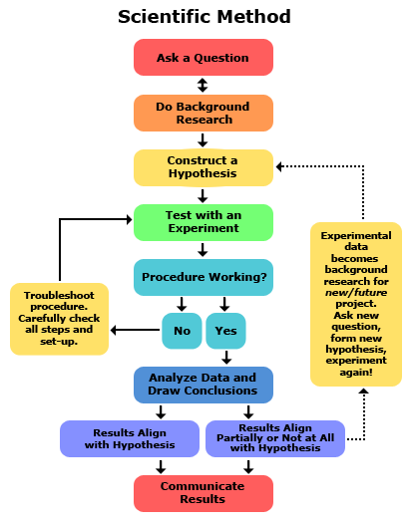
II. Develop a plan for the student to understand the fundamentals of experimental design.
This is an iterative process that must be part of an ongoing conversation between the student and mentor:
After identifying a critical gap in knowledge to be addressed, can the student formulate an explicit hypothesis that can be tested?
For short research projects, these should usually be narrowly constructed hypotheses that address a very specific question using a limited number of techniques.
Experimental factors including well defined variables and controls for those variables should be explicitly defined.
Expected outcomes should be discussed before doing experiments.
www.sciencebuddies.org
2023 Snow Season Education Retreat

Slide 14
II. Develop a plan for the student to understand the fundamentals of experimental design.
This is an iterative process that must be part of an ongoing conversation between the student and mentor:
Experiments will probably not work perfectly at first – this is okay, students learn more from troubleshooting and understanding why something didn’t work than they do if everything works perfectly the first time!
Unexpected results don’t always mean the student has done something wrong – initial experiments sometimes don’t take all the variables into account they should have, or the results may be telling there is something new and exciting happening you didn’t expect.
Experiments not working or producing unexpected results are excellent teaching moments!
www.sciencebuddies.org
2023 Snow Season Education Retreat

Slide 15
III. Develop a plan for the student to understand the analysis and interpretation of data.
www.thebiologynotes.com
Training in data analysis and interpretation depends on two factors:
The type of data being collected
The student’s background and previous training in this area.
2023 Snow Season Education Retreat

Slide 16
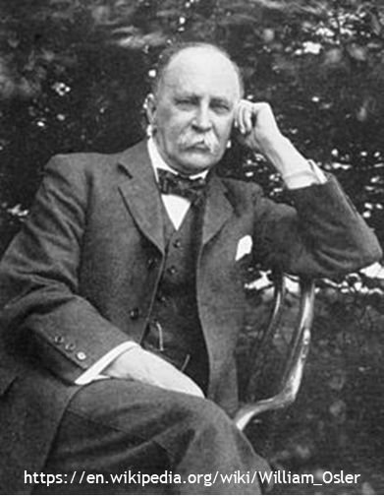
IV. Develop a plan for the student to effectively communicate their results.
Effective communication skills, both written and oral, are a critical component of the scientific process. As part of their research project all students should:
Provide a written paper summarizing their results – even if they didn’t work (that is great discussion material)!
Have an opportunity to present their work orally, either as a poster presentation or as a short talk.
"In science, the credit goes to the [one] who convinces the world, not to the [one] to whom the idea first occurs."
--Sir William Osler
Effective scientific writing and speaking are both learned skills that require both mentoring and practice.
2023 Snow Season Education Retreat

Slide 17
V. Putting it all together – how is all of this accomplished in a short research project?
Establish regular and frequent one-on-one meetings between the mentor and student.
Each meeting should have a defined agenda (e.g., background, experimental design, data analysis, communication skills, etc.).
Clear expectations for both the overall research experience and specific mentoring meetings should be well defined – a written document at the start of the project defining the responsibilities of both the mentor and the student can be very useful.
Who is doing which aspects of the training should be clearly define. Will the mentor do all the training? Will other lab members be responsible for specific aspects of the training?
Participation in lab meetings and relevant seminars can greatly enhance the training environment and outcomes, as well as provide opportunities to hone communications skills.
2023 Snow Season Education Retreat

Slide 18
Questions?
2023 Snow Season Education Retreat

